Slide 1
LIP INJECTION EXTREME PLUMPING CLICKS
SHARP GRABBER:
Too Faced is the #1 lip plumping brand in Canada and with our new Lip Injection Extreme Plumping Clicks, you are just one click away from the plumpest, juiciest lips you have been looking for.
LEARNING OBJECTIVE & WIFM:
By the end of our time together you will be an expert on our lip plumping franchise. You’ll learn what makes Lip Injection Extreme Plumping Clicks so amazing, what clients will love it and what Too Faced BFFs pair best with this new launch!
BRAND DNA:
At Too Faced we believe makeup is power giving our clients the freedom to express themselves and the confidence to take over the world! Our goal is to give you the tools to create your own looks, find what you love and OWN YOUR PRETTY We are a cruelty free brand and unabashedly pink & feminine. We instill confidence & stand for kindness.
INNOVATION:
Introducing the newest member of our plumping family, Lip Injection Extreme Lip Plumping Clicks!
Features:
This new launch will give your pout a powerful plump appearance and a kiss of dewy, high-shine colour. This nourishing lip balm stick melts onto your lips for intense hydration and a fresh strawberry scent.
SRP: $38
OCD: January 2025

Slide 2
Benefits & Key Claims
8-hour hydration & one swipe color payoff
Creamy formula melts on & plumps lips instantly with just 1 click
Sheer-to-medium buildable coverage with high-shine color.
Available in 8 juicy shades with names that compliment your clique energy
Smells like fresh strawberries
RETENTION:
Q: What three Too Faced BFFs could you pair with this new launch?
A: Cloud crush blush, Kissing Jelly, etc.
Q: What client will love the new Lip Injection Extreme Plumping Clicks
A: The client that loves lip plumping products, the client that loves hydrated, glossy lips, a client that loves a creamy, lip balm texture.
Who is it for?
Someone looking for a plumping lip product with colour.
Someone who wants hydration & instant plump.
Someone who loves high-shine color.
How do you use it?
Click the adorable, non-retractable heart-shaped base to reveal the perfect amount of product every time. Glide product back and forth across your lips to achieve a beautiful kiss of high-shine colour. Do not over click!
CALL TO ACTION:
I challenge you to introduce 3 clients to our new Lip Injection Extreme Lip Plumping Clicks, encourage them to try on to experience the creamy texture and share the benefits of our lip plumping products.
Additional Training
Assets:
Here
Pro Tip
Pair with Lip Injection Lip Shaper for a more defined, extra plump pout.

Slide 3
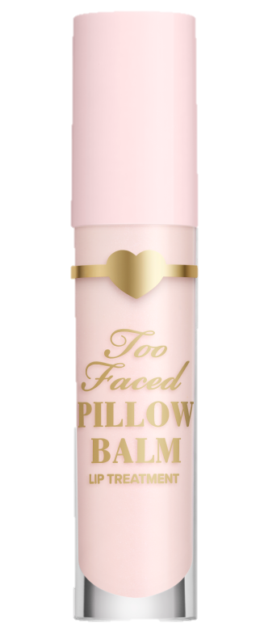
PILLOW BALM
ULTRA-HYDRATING AND NOURISHING LIP TREATMENT
SHARP GRABBER:
It’s time to treat your lips to a hyaluronic acid infused balm that will deliver pillowy-soft lips in 6 new shades.
LEARNING OBJECTIVE & WIFM:
By the end of our time together you will be an expert on Pillow Balm and know what makes it amazing, what clients will love it, and Too Faced BFFs to pair with it.
BRAND DNA:
At Too Faced we believe makeup is power giving our clients the freedom to express themselves and the confidence to take over the world! Our goal is to give you the tools to create your own looks, find what you love and OWN YOUR PRETTY We are a cruelty free brand and unabashedly pink & feminine. We instill confidence & stand for kindness.
INNOVATION:
Introducing our newest formulation of Pillow Balm Ultra-Hydrating and Nourishing Lip Treatment
Features:
Deeply hydrate and improve the appearance of fine lines with this luxuriously rich and creamy liquid lip balm treatment infused with a nourishing complex of fruit oils, conditioning butters, and hyaluronic acid. Use day and night to help prevent moisture loss for ultra-hydrated, pillowy-soft lips with just a kiss of colour.
SRP: $36
OCD: January 2025

Slide 4
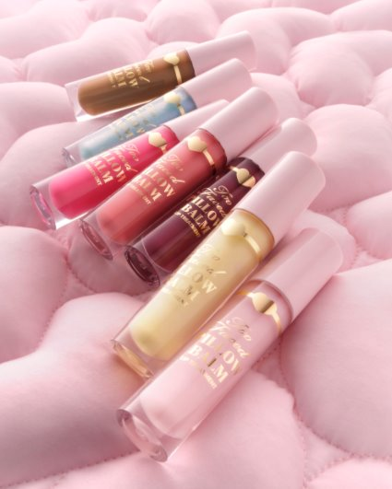
Benefits & Key Claims
100% of panelists saw an increase in moisture immediately
Creates a protective barrier over lips that prevent lips from drying out
Infused with a nourishing complex of fruit oils, conditioning butters and hyaluronic acid to deeply hydrate and help minimize the look of lines on lips immediately and over time.
RETENTION:
Q: What Too Faced BFFs could you pair with this new launch?
Q: What client will love Pillow Balm
Q: What key ingredients and benefits can you share with your client?
CALL TO ACTION:
Introduce 3 new clients to our Pillow Balm, share the key ingredients and benefits and let them know about another Too Faced BFF that would pair perfectly with this product.
Who is it for?
Someone who loves a scented lip balm.
Someone who wants a balm with nourishing & hydrating ingredients.
How do you use it?
Apply morning and night to help prevent moisture loss for intensely-hydrated, pillow-soft lips.
Additional Training
Assets:
Here
KEY INGREDIENTS:
Hyaluronic Acid helps skin hydration
Shea Butter & Mango Seed Butter help nourish and condition
Olive fruit oil & Avocado oil help nourish and condition
Vitamin E known source of antioxidant

Slide 5
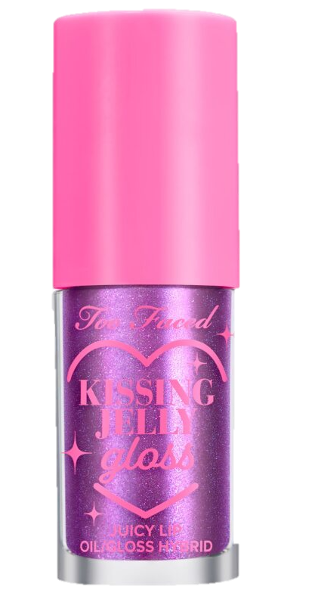
KISSING JELLY- Shade Extension
JUICY LIP OIL/GLOSS HYBRID
SHARP GRABBER:
Are you excited to see our newest shades in our ultra-nourishing lip oil/high-shine gloss hybrid that feel so comfy and smells delicious?
LEARNING OBJECTIVE & WIFM:
By the end of our time together you will be an expert on Kissing Jelly and know what makes it amazing, how to apply, what clients will love it, and Too Faced BFFs to build the basket with!
BRAND DNA:
At Too Faced we believe makeup is power giving our clients the freedom to express themselves and the confidence to take over the world! Our goal is to give you the tools to create your own looks, find what you love and OWN YOUR PRETTY We are a cruelty free brand and unabashedly pink & feminine. We instill confidence & stand for kindness.
INNOVATION:
Introducing our new and Sephora exclusive shades of Kissing Jelly in Birthday Kiss, Strawberry Frosting and Cherry Pie. YUM!
Smells like Vanilla Birthday Cake!
Smells like Strawberry Frosting!
Smells like Cherry Pie!
Features:
This intensely hydrating, high-shine lip oil gloss hybrid is infused with sunflower and jojoba seed oils to promise 12-hour moisture. It’s always comfortable on the lips, never sticky and has a generous-sized doe-foot applicator to evenly distribute lip oil gloss on the lips.
Vegan and cruelty free.
SRP: $30
OCD: January 2025

Slide 6
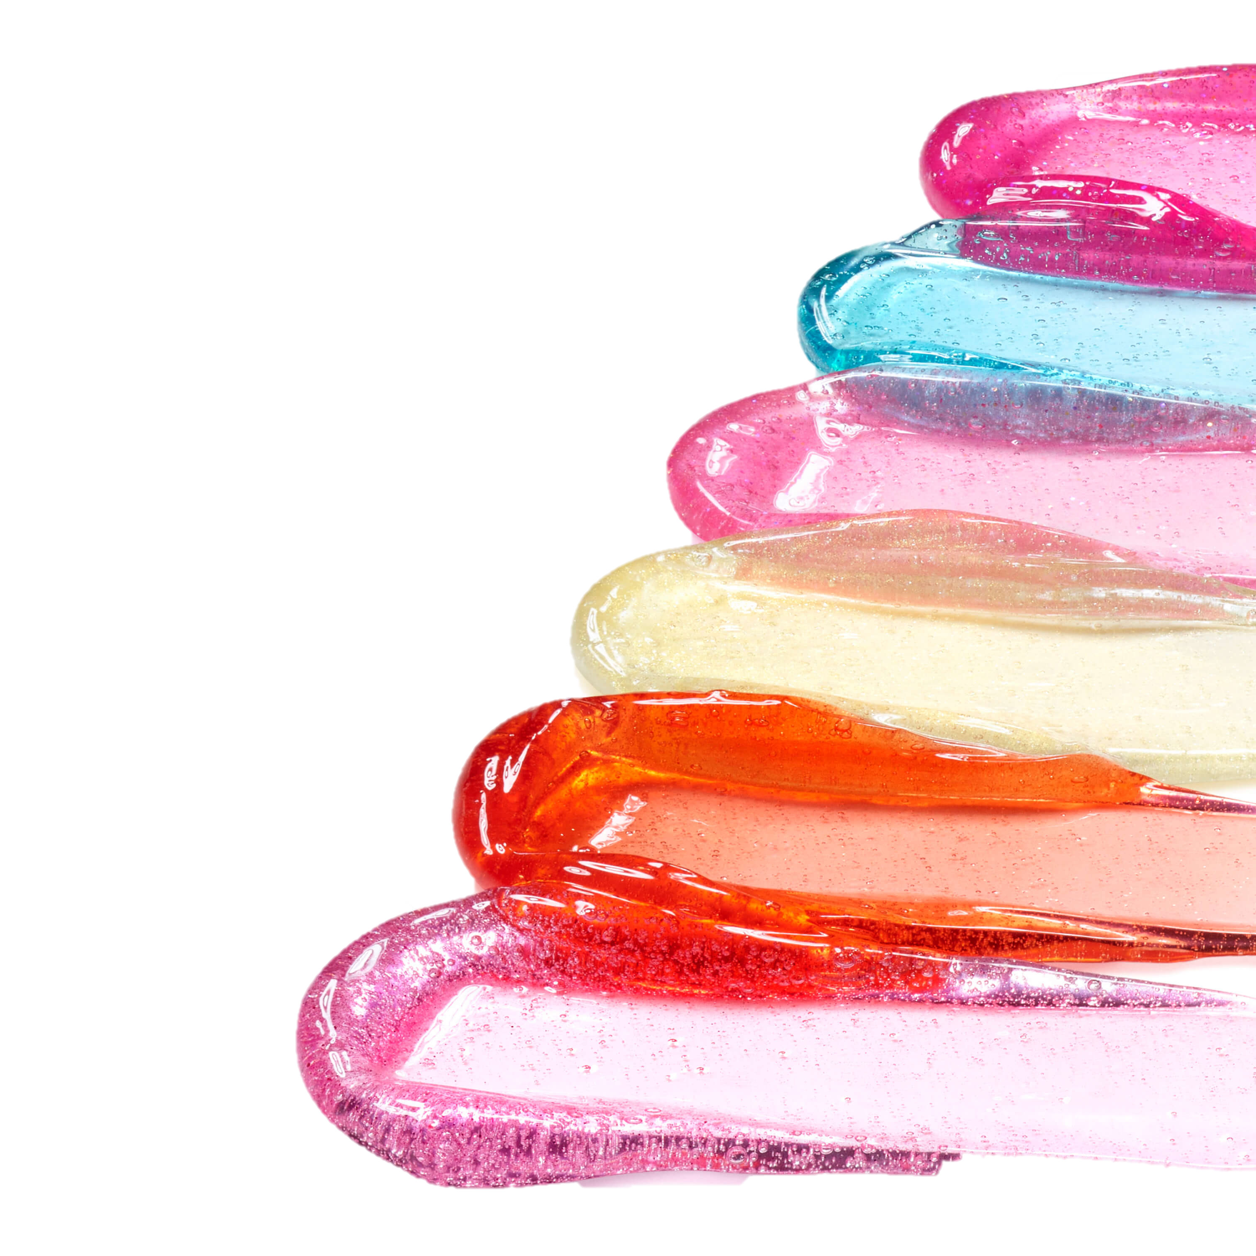
Benefits & Key Claims
-Ultra-nourishing, infused with sunflower and jojoba seed oils.
-Promises 12-hour hydration and immediate shine.
-Always comfy, never sticky.
-Available in 9 colors/scents and 2 finishes
- Vegan.
Pro Tip
Pair with Lip Injection Extreme Lip-Shaper for a more defined, extra plump pout and a high-shine gloss look.
Layer over top of your favorite lipstick for a custom shade and lip look.
Who is it for?
Someone looking for a high-shine lip oil gloss
Someone looking for a non-plumping gloss
Someone looking for a lip oil gloss at an affordable price
Someone that loves fun colours and scents in their products
How do you use it?
Apply directly onto clean, dry lips using the doe-foot applicator. Lay the doe-foot applicator flat against the lips to evenly distribute with a back-and-forth motion.
RETENTION:
We know there are a lot of lip oils currently winning in this space. What is unique about Kissing Jelly? Listen for: fun colours & scents, options for finish (crystal clear tinted & sheer pearl), affordable price point, lip oil-gloss hybrid.
What Too Faced BFFs can we link-sell with Kissing Jelly?
CALL TO ACTION:
I challenge you to introduce 3 clients to Kissing Jelly and share the benefits. Bonus points for adding it into the basket!
SHARE: Phrase that Pays
“Treat yourself to Kissing Jelly, an ultra-nourishing lip oil/gloss hybrid. It comes in 9 irresistible scents. Let’s find your fave scent!
Additional Training Assets:
Here

Slide 7
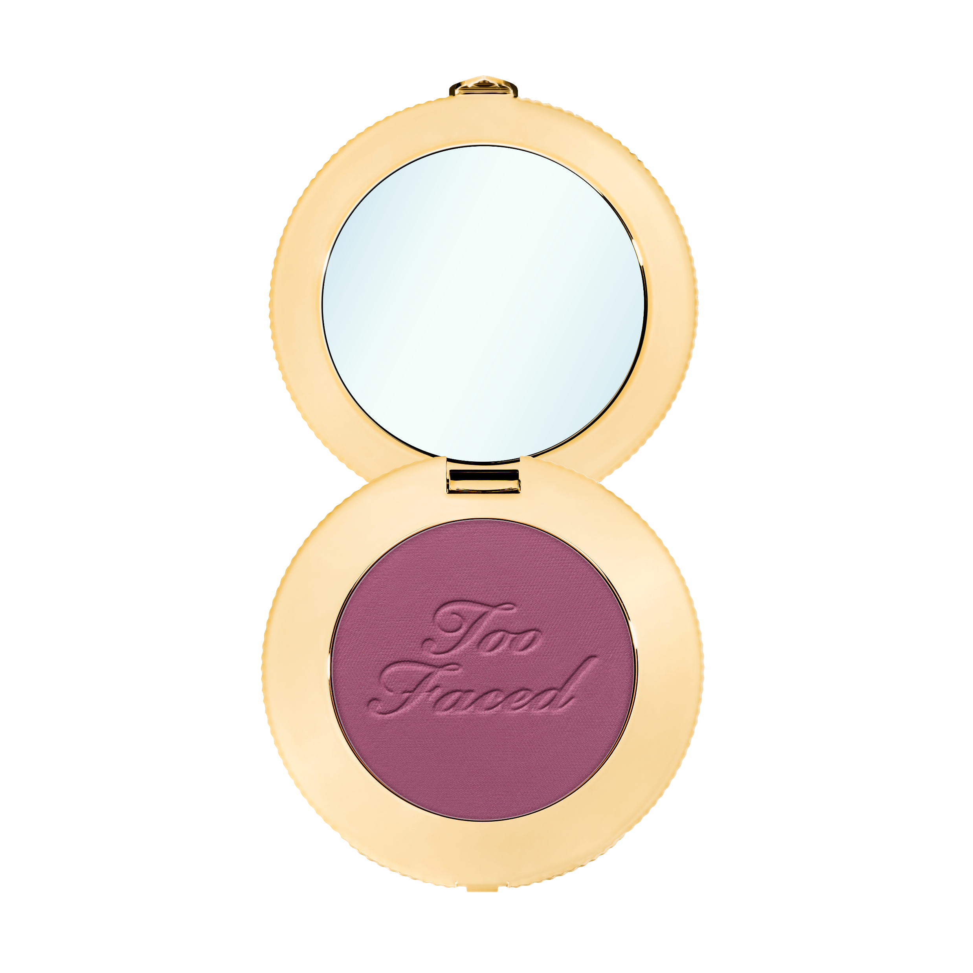
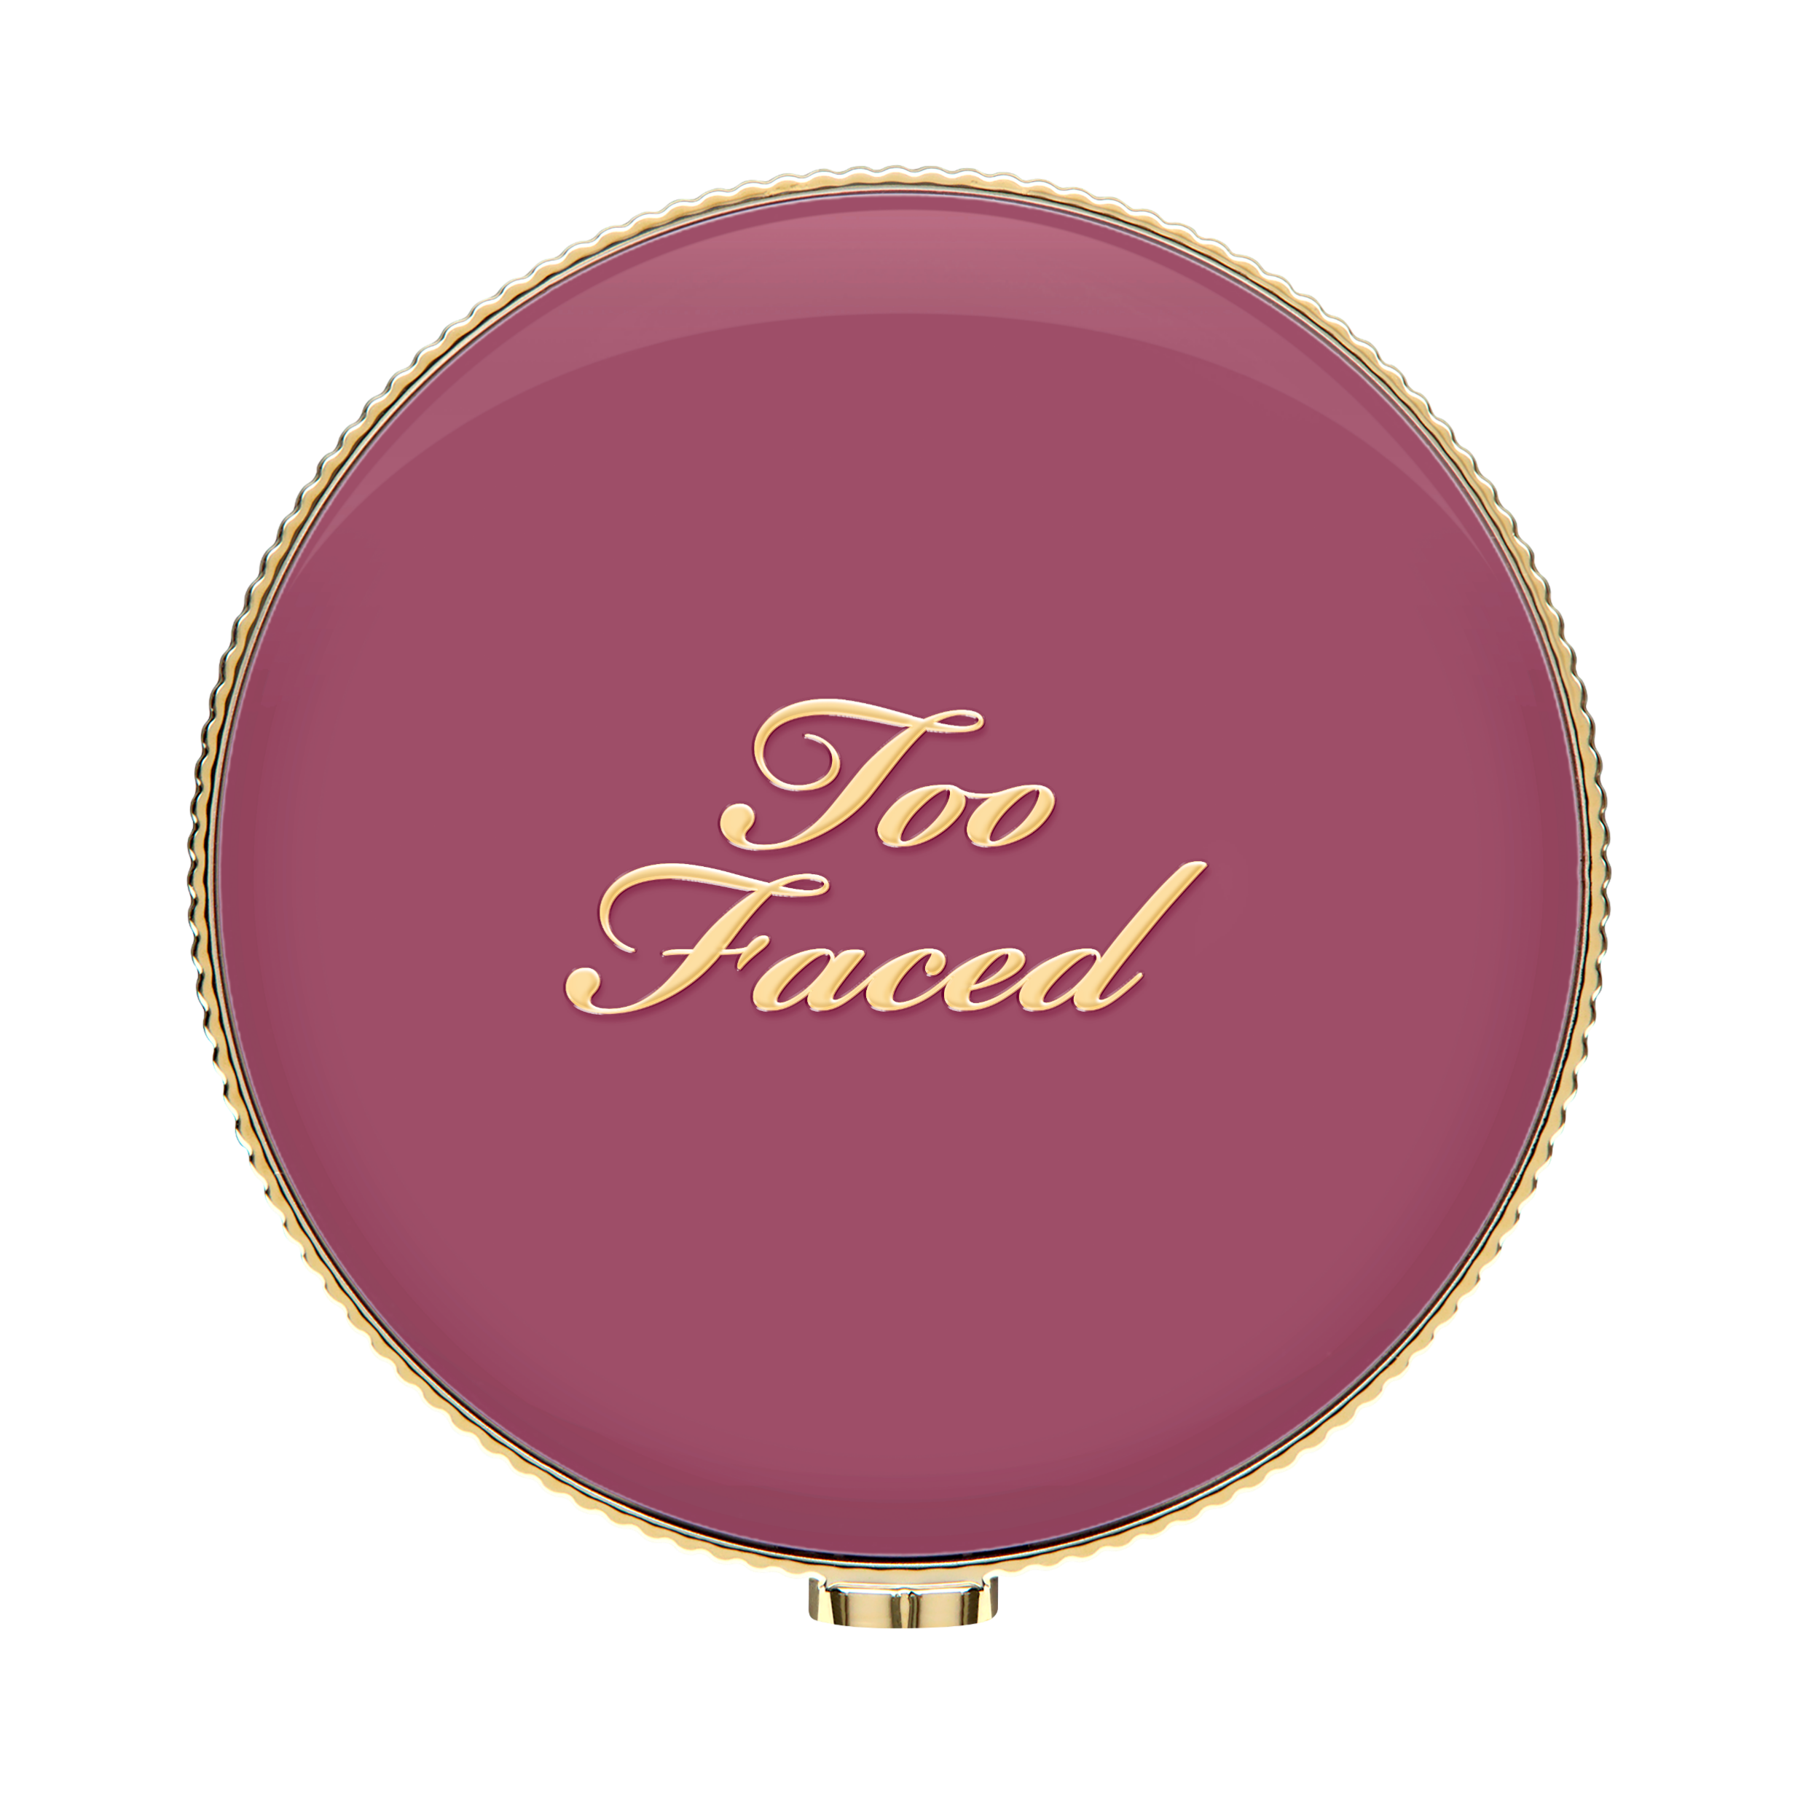
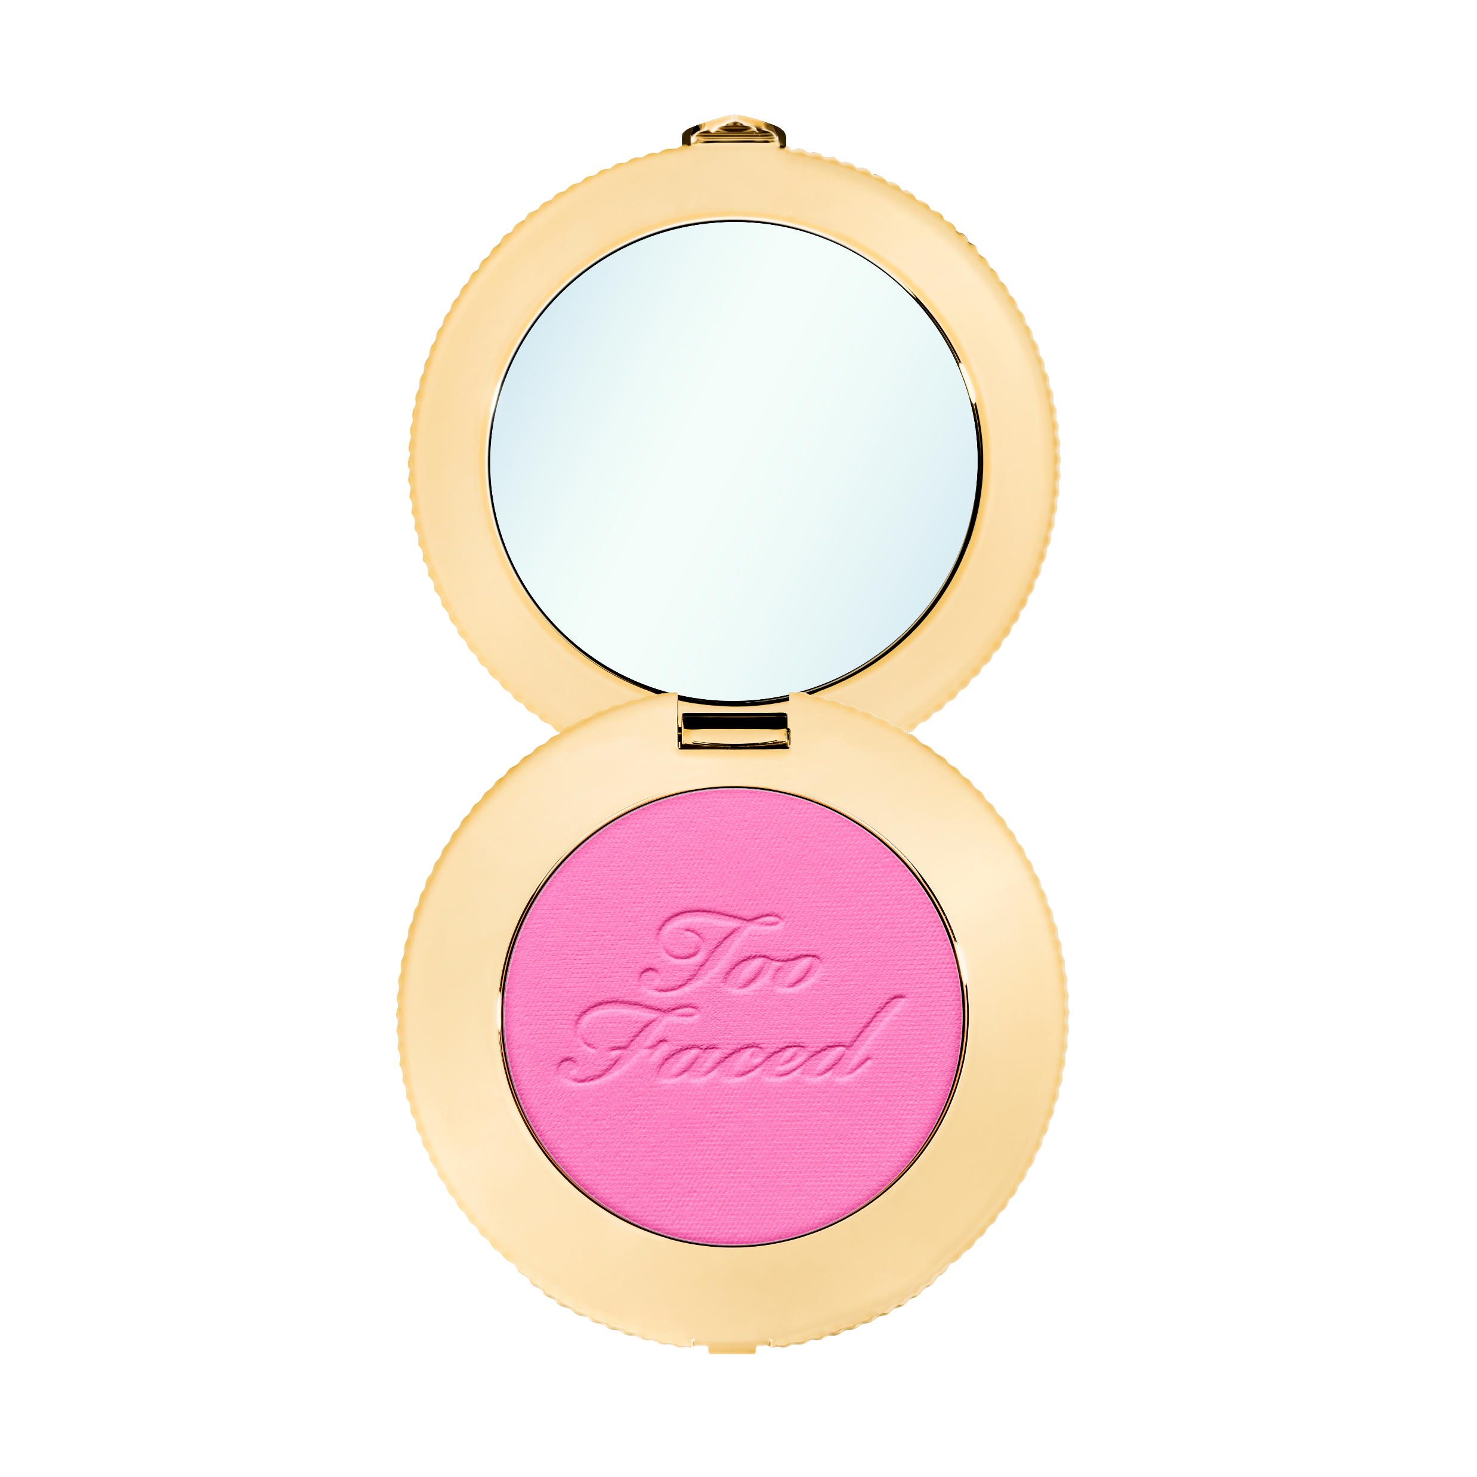
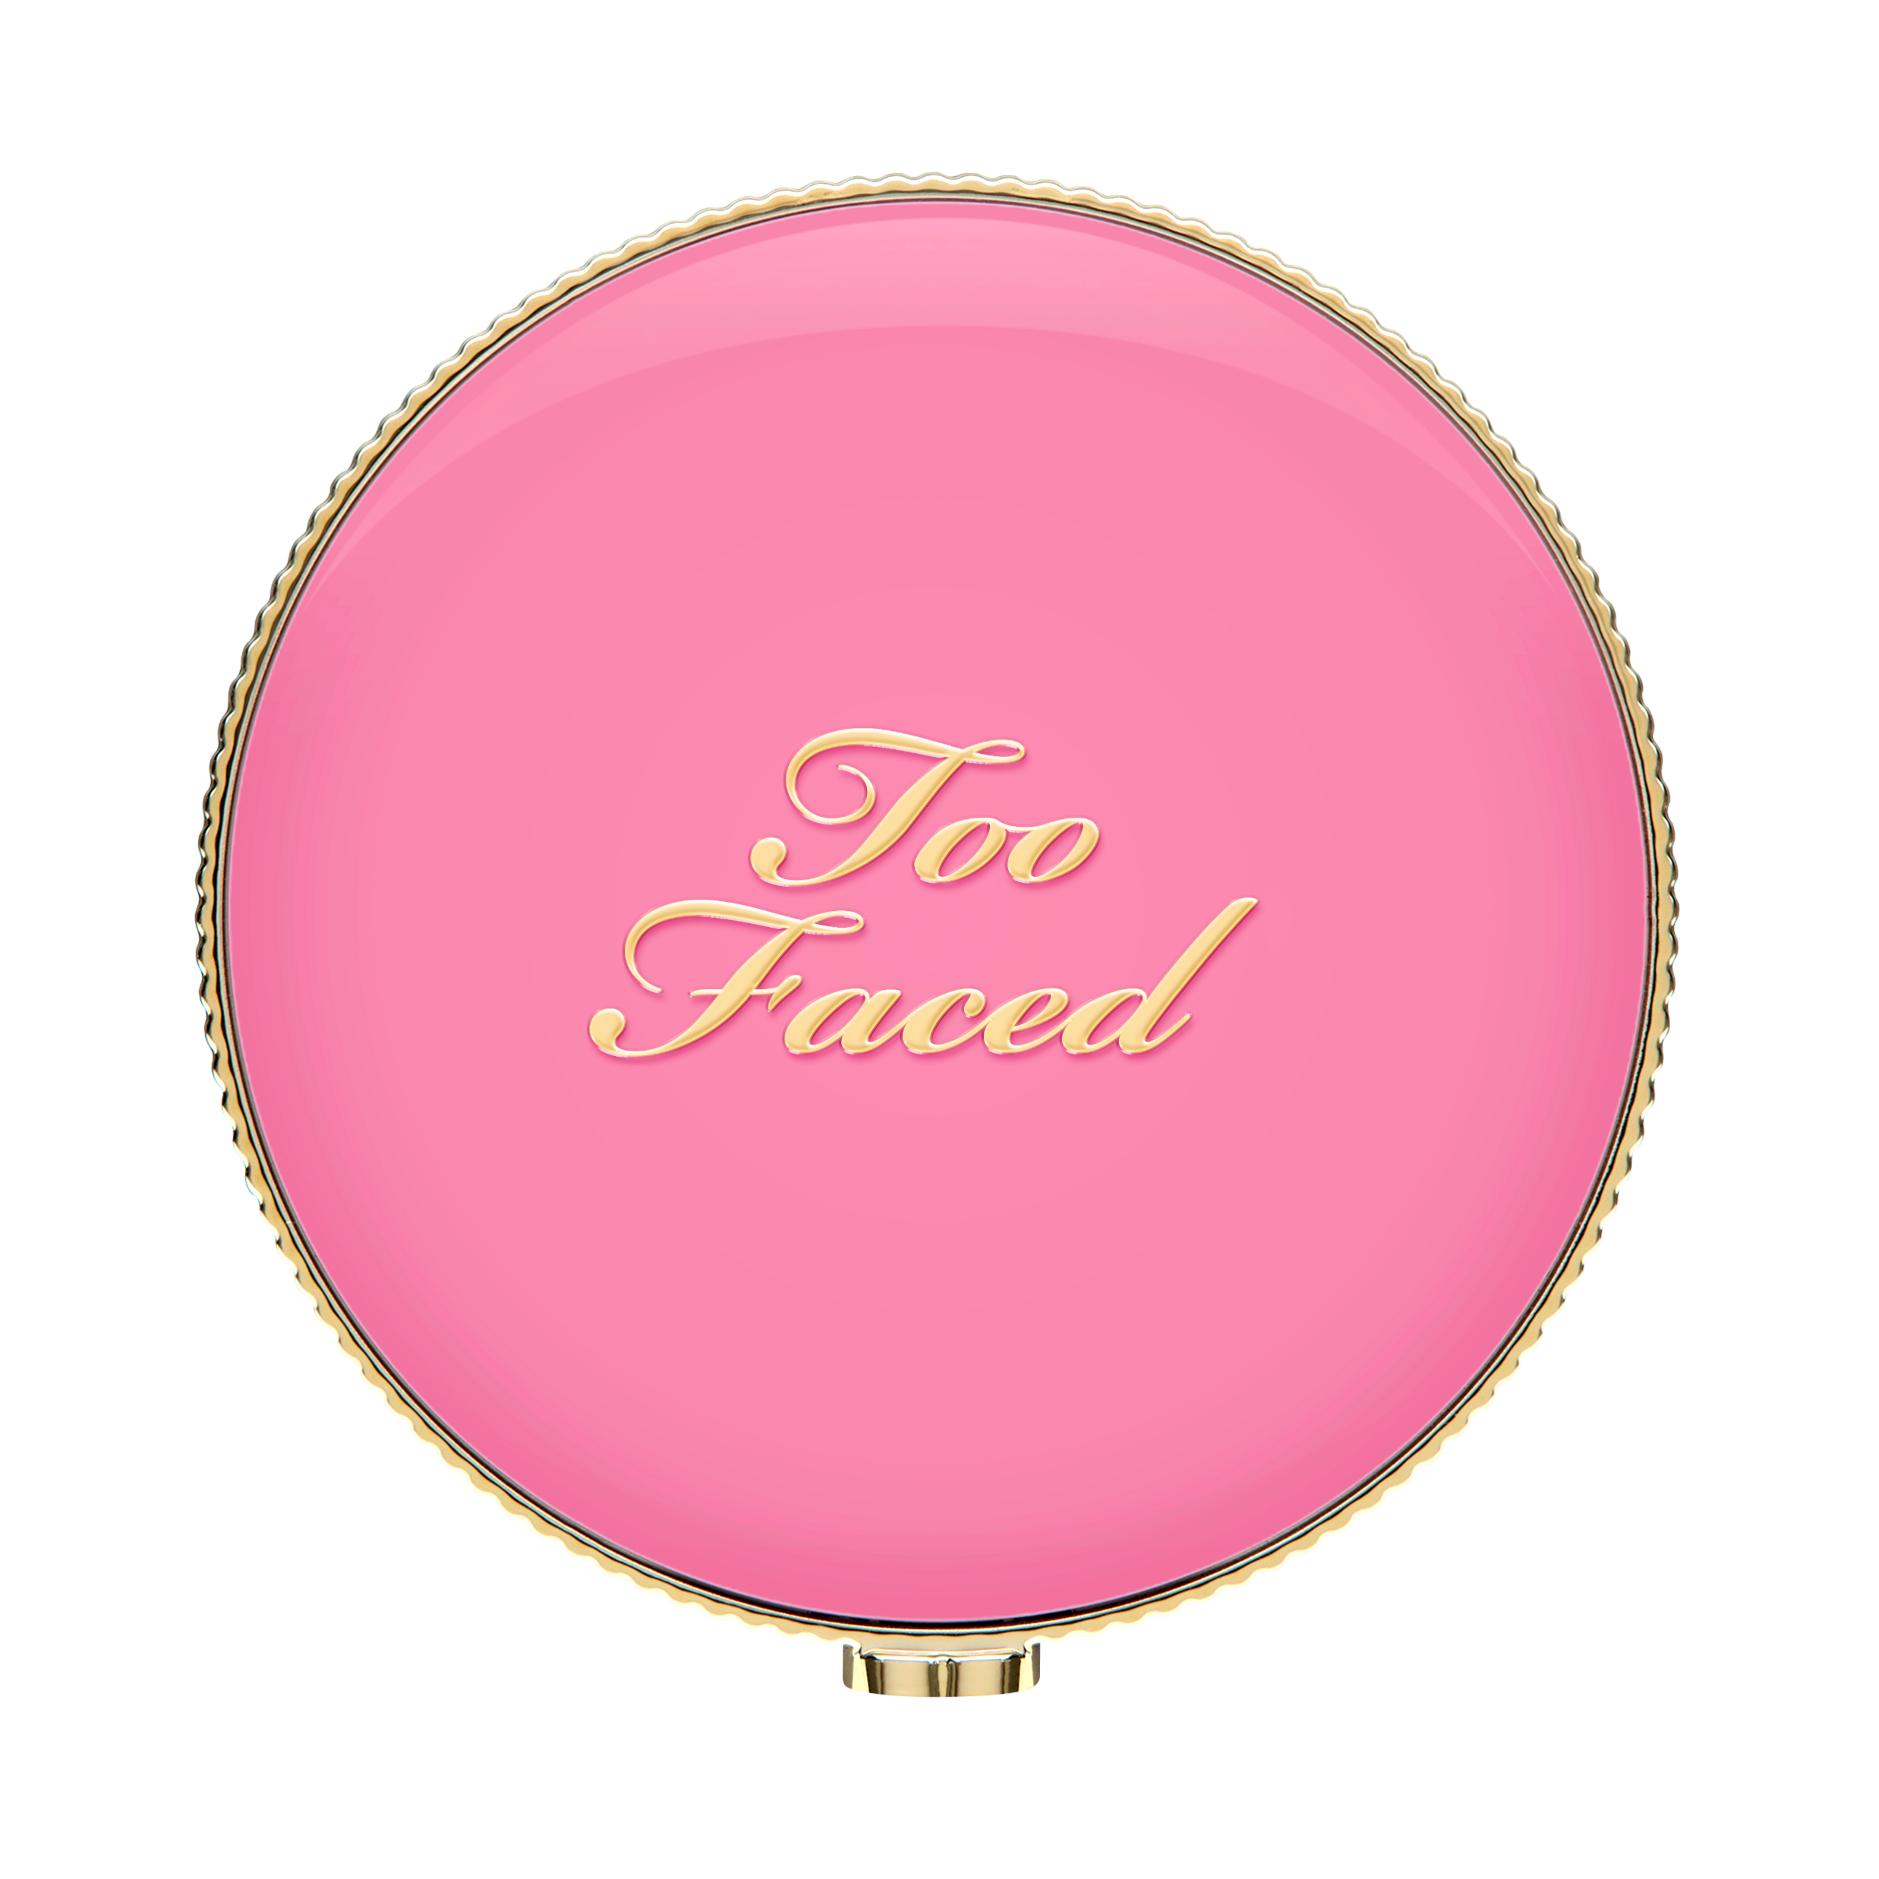
CLOUD CRUSH BLURRING BLUSH- Shade Extension
SHARP GRABBER:
Are you ready to experience a cloud-like kiss of colour with the new shades of Cloud Crush Blurring Blush?
LEARNING OBJECTIVE & WIFM:
By the end of our time together you will be able to share with your clients what makes our Cloud Crush Blush so unique and who will love it.
BRAND DNA:
At Too Faced we believe makeup is power giving our clients the freedom to express themselves and the confidence to take over the world! Our goal is to give you the tools to create your own looks, find what you love and OWN YOUR PRETTY <3 We are a cruelty free brand and unabashedly pink & feminine. We instill confidence & stand for kindness.
INNOVATION:
Introducing two new exciting shades of our Cloud Crush Blurring Blush in Super Candy Clouds and Crimson Skies!
Features:
Give your cheeks a cloud-like kiss of colour with this airy, diffused blurring blush. Infused with a flower extract blend, this ultra-smooth, cushiony velvet powder offers a seamless wash of buildable, rejuvenating color for a natural blurring effect with a soft, second-skin feel that wears like a dream.
SRP: $43
OCD: January 2025

Slide 8
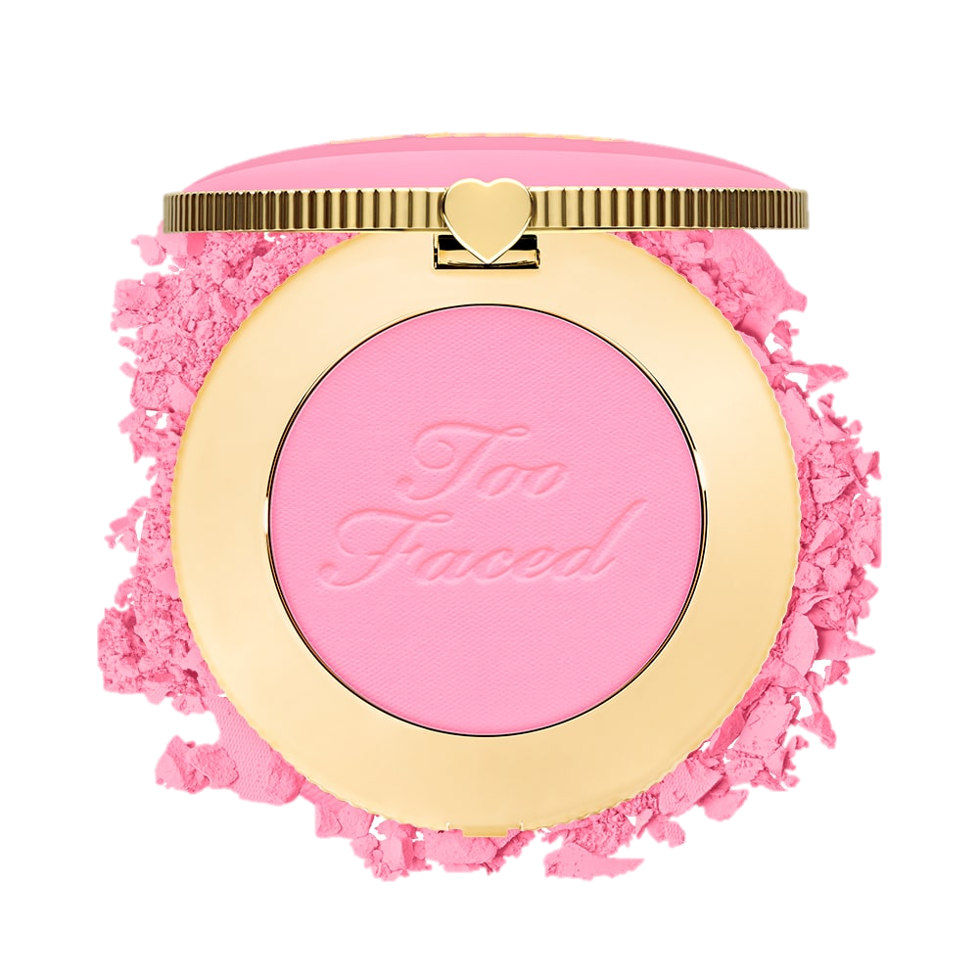
Benefits & Key Claims
93% naturally-derived ingredients
Infused with a flower extract blend that helps create a smooth application.
Buildable, blendable, cloud-like kiss of colour
Smells like a walk on a tropical beach
Cute macaron inspired compact
Safe for sensitive skin
RETENTION:
What Too Faced BFF could you pair with Cloud Crush Blush?
What makes Cloud Crush Blush so unique?
CALL TO ACTION:
I challenge you to introduce 5 clients to the new Cloud Crush Blush and pair it with our Born This Way foundation for a flawless complexion.
Who is it for?
A client that is looking for blush that will not accentuate lines and texture
A client that wants buildable payoff
A client that struggles to find a blush that shows up on them and stays all day
A client that wants a blush that adds a pop of colour but still looks natural.
How do you use it?
Swipe onto apples of cheek, swirling in a circular motion to blend, layering to desired intensity. Sweep excess across the hairline, bridge of nose, and chin.
Selling Phrase
“To complete your Born This Way complexion look, apply Cloud Crush Blush for the perfect pop of colour.”
Additional Training
Assets:
Here

