Slide 1
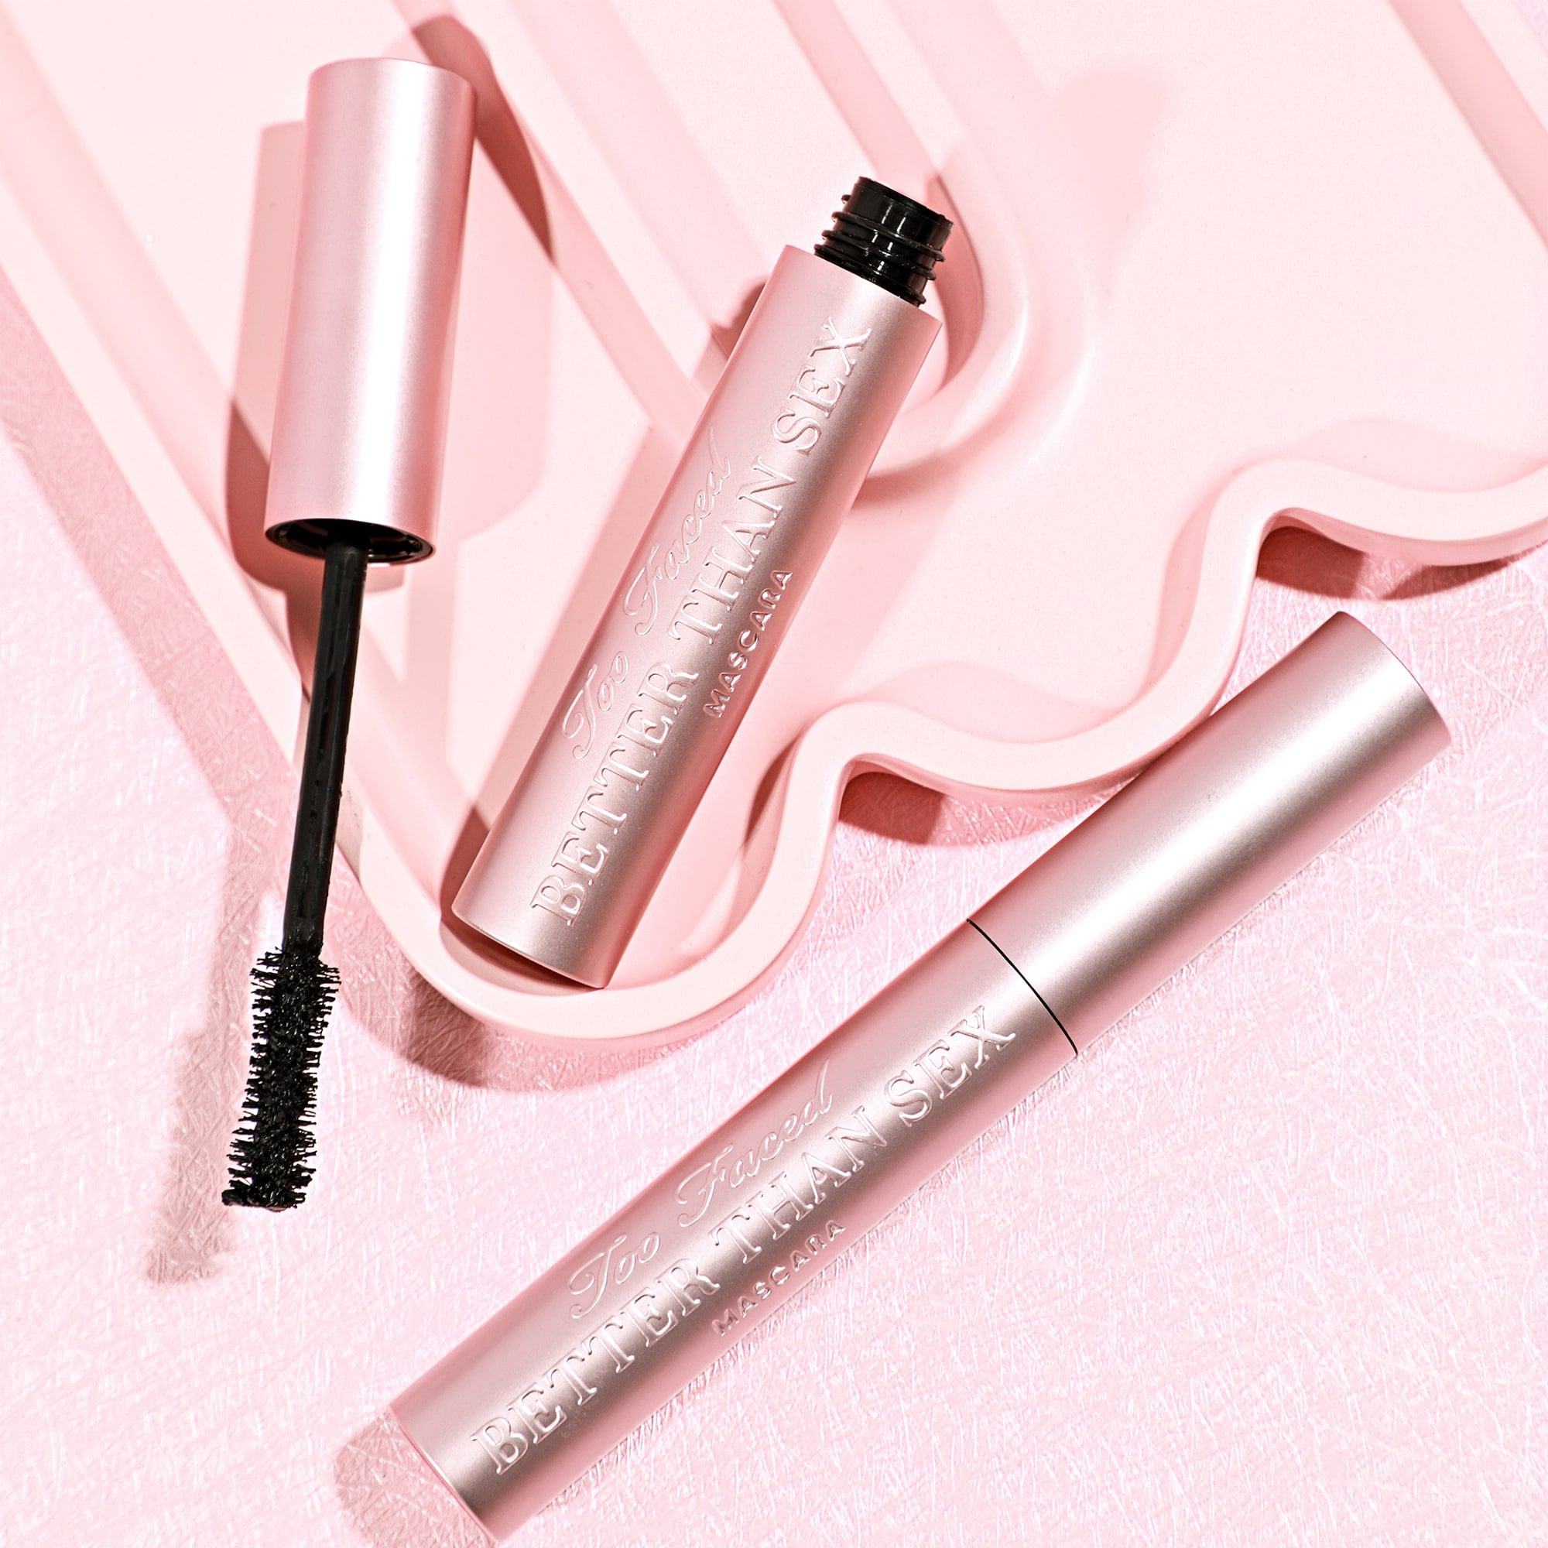
About the Brand (brand DNA)
At Too Faced we believe makeup is power giving our clients the freedom to express themselves and the confidence to take over the world! Our goal is to give you the tools to create your own looks, find what you love and OWN YOUR PRETTY <3 We are cruelty free brand and unabashedly pink & feminine. We instill confidence & stand for kindness.
BETTER THAN SEX MASCARA
This mind-blowing mascara features our iconic formula that thickens, lengthens, and curls for extreme volume and dramatic lashes. It’s a mascara so amazing . . . it's Better Than Sex!
What makes it amazing:
AWARD-WINNING FORMULA
Thickens, lengthens and curls in just one coat
HOURGLASS-SHAPED BRUSH
• Grabs and lifts lashes for an easy and effortless rich application of mascara
• Coats every little lash, with no lash left behind
FEATURED INGREDIENTS
• Film-forming polymer locks curl in place
• Acacia Senegal Tree Extract sets volume
• Peptides conditions lashes
Supporting Assets:
Better Than Sex One-Pager
Training Deck: Better Than Sex Franchise
NALX Link
Call to Action:
Add three Better Than Sex mascaras to any Too Faced basket. Share the benefits of this #1 selling mascara and the different options that are available (waterproof, chocolate, etc.) to find your clients perfect fit.
Retention:
What benefits will your client love from this mascara?
What Too Faced BFF could you add to the basket to compliment this mascara?
What client will love this mascara?

Slide 2
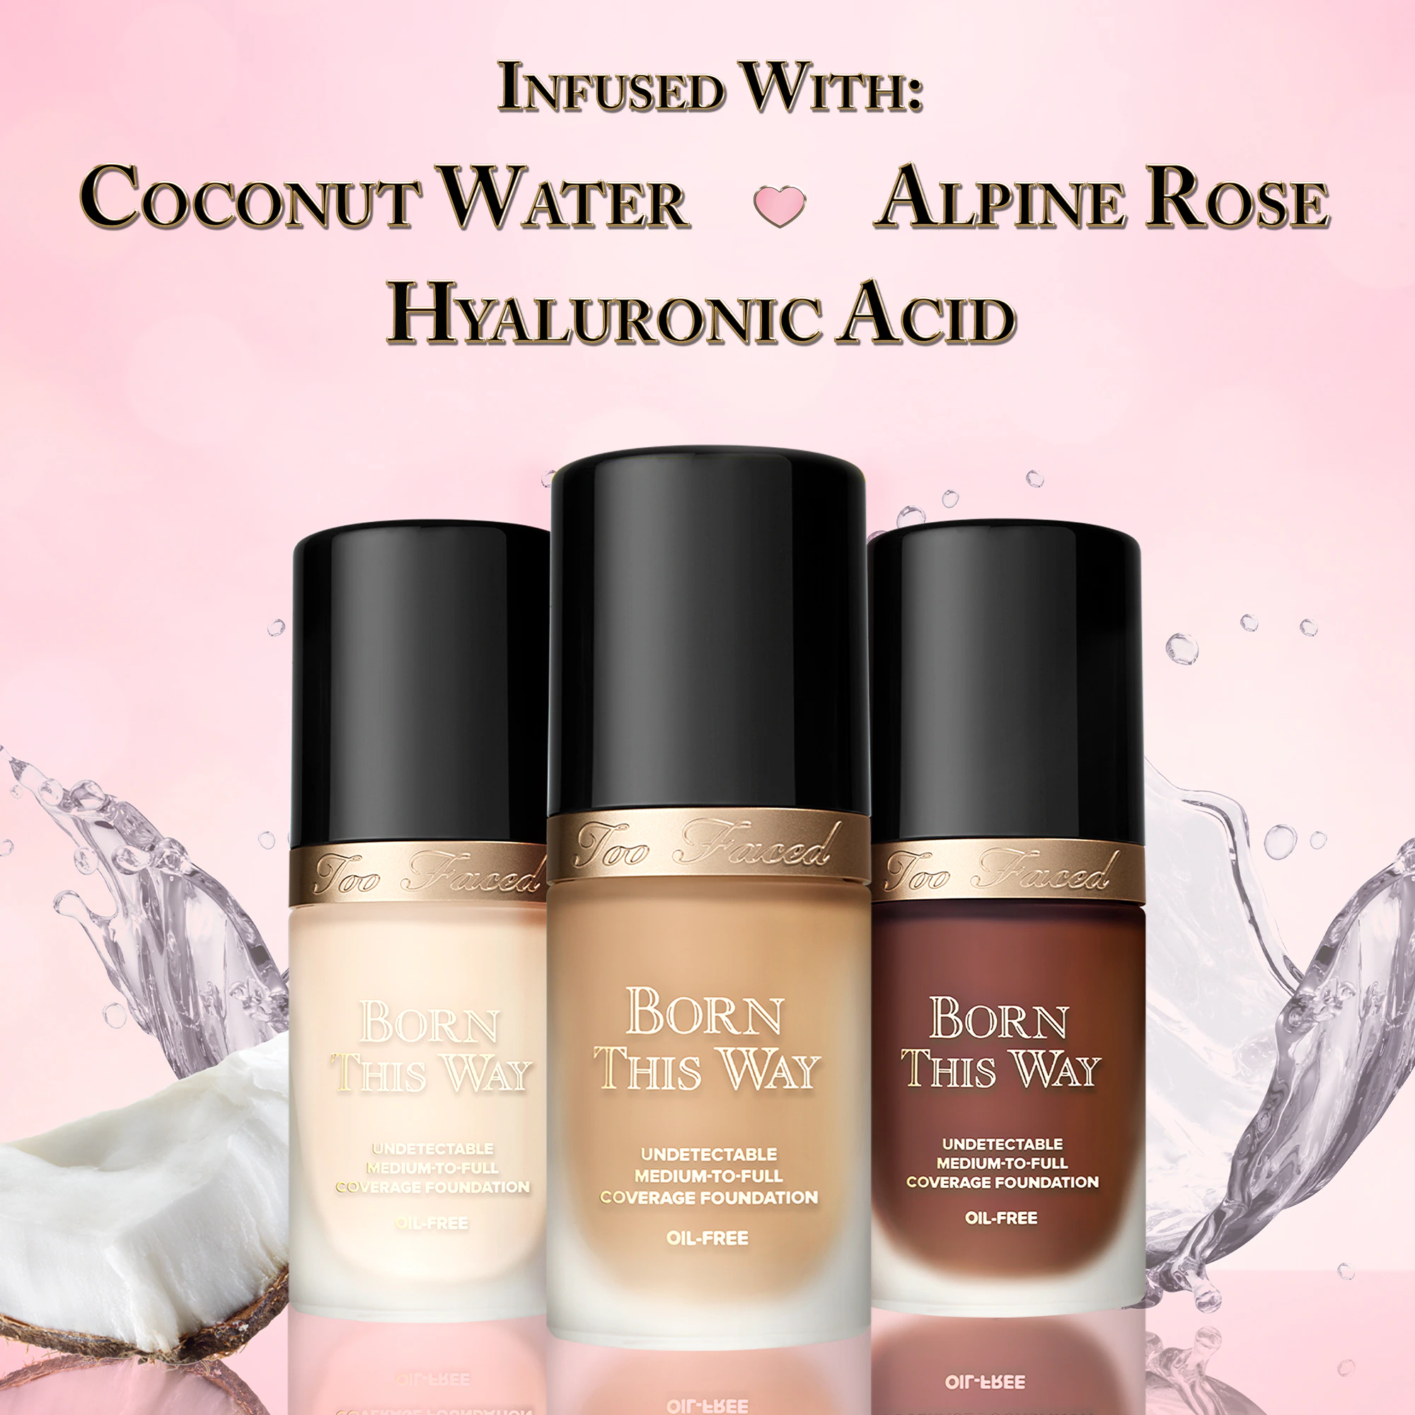
Insert High Res Brand Logo from Bank on slide 2
Share Features, Benefits, 1 clinical claim & wow demo
BORN THIS WAY FOUNDATION
This medium-to-full coverage, foundation masterfully diffuses the line between makeup and skin for a perfect, naturally flawless finish.
What makes it Amazing:
MEDIUM-TO-FULL UNDETECTABLE COVERAGE
This easily buildable for medium-to-full coverage formula has a natural finish, blurs imperfections and is longwearing. It’s also non-comedogenic, photo friendly/gives no flashback!
COMFORTABLE WEAR THAT'S HYDRATING
This foundation is infused with Coconut Water to aid in delicately replenishing skin's moisture levels, Alpine Rose to help empower skin's health and radiance, and Hyaluronic Acid for a smoother, more youthful appearance.
Video, One pager, Social linked here
Call to Action:
What challenge and/or action are you going to ask your attendees to put into play after your training?
*Tip* It needs to be specific and attainable.
Always ask them to share it with you when they have achieved it.
Retention Examples:
-Share 3 key benefits/features of this new product.
-Share 1 POD about the brand.
-Who is this product for?
-How do you use this product?
Supporting Assets:
Born This Way One-Pager
Training Deck: Born This Way Franchise
NALX Link
Call to Action:
Introduce 3 clients to our Born This Way foundation, find their perfect match and share the skin-loving ingredients that make this formula unique. Let your client know what other Too Faced product they will fall in love with to complete their complexion look.
Retention:
What client will love our Born This Way Foundation? What are the three skin care ingredients in our Born This Way complexion franchise and what are their benefits?
What Too Faced BFF could you pair with the Born This Way Foundation?

Slide 3
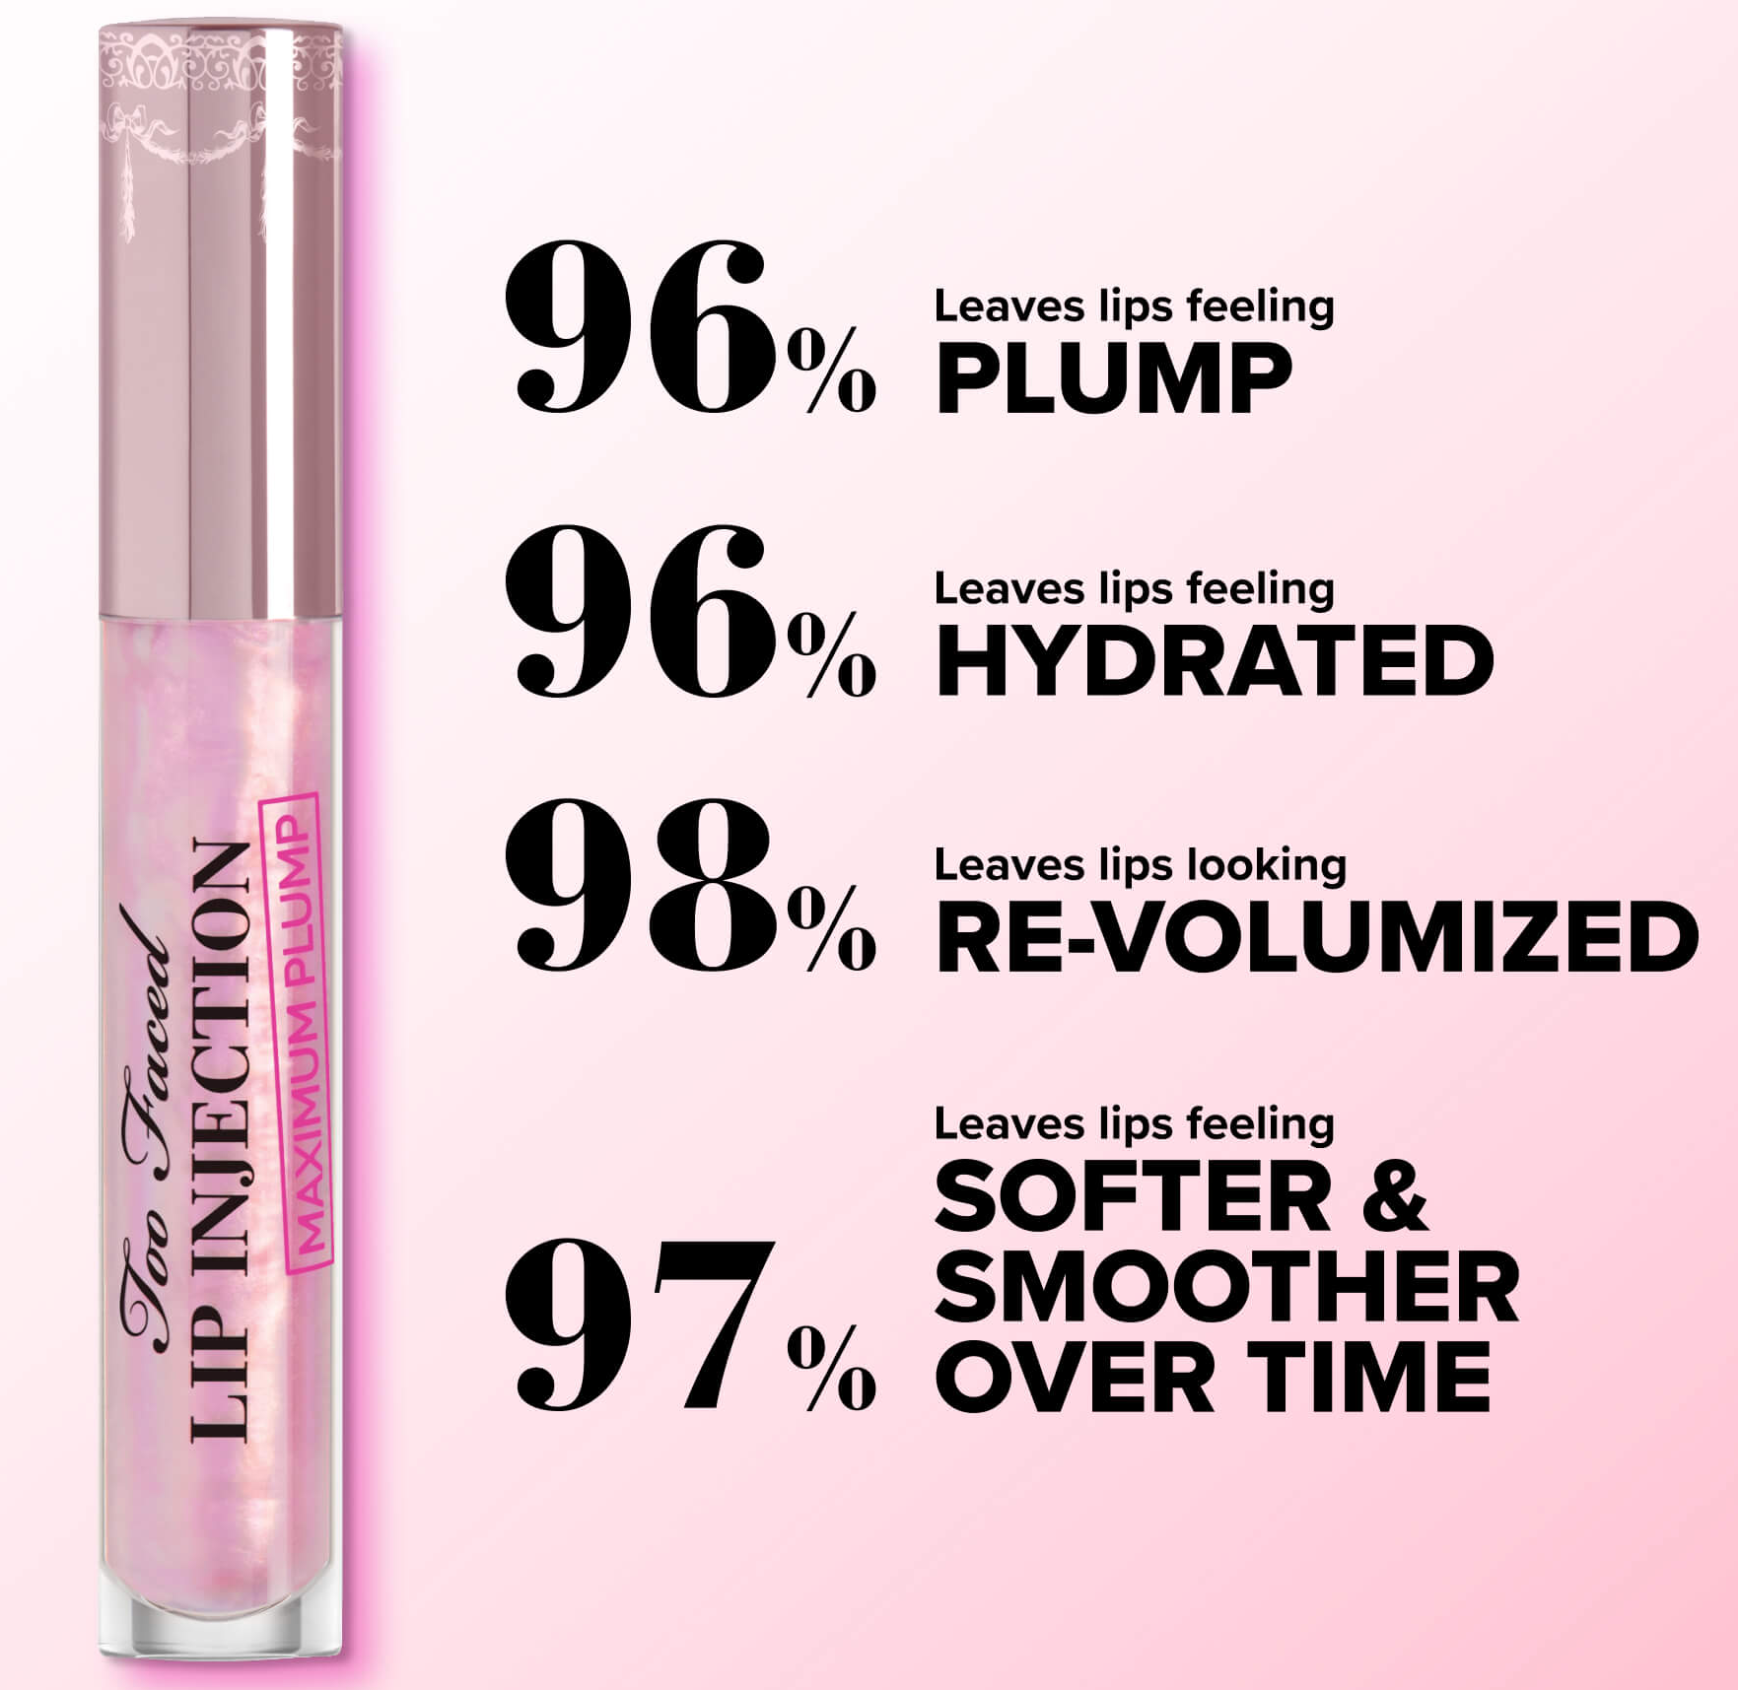
Insert High Res Brand Logo from Bank on slide 2
Share Features, Benefits, 1 clinical claim & wow demo
Video, One pager, Social linked here
LIP INJECTION MAXIMUM PLUMP
The ultimate lip plumping formula that creates max results where lips appear plumped, hydrated, and nourished immediately, and over time!
What makes it Amazing:
POWERFULLY EFFECTIVE ADVANCED FORMULA FOR A TRUE PLUMPING ADDICT
This plumping gloss gives an immediate tingly sensation that showcases the instant max plumping technology. It’s formulated with jojoba oil and vitamin E to provide hydration and nourishment. Leaves lips feeling plumped & re-volumized right away and enhances plumped lips over time.
LAB-TESTED BLEND OF INGREDIENTS FOR LONG-TERM RESULTS
Atelocollagen, Marine Filling Spheres, nourishing Avocado and Jojoba oils, and antioxidant Vitamin E create the unique ability to offer long-term, lasting plumping effects.
Call to Action:
What challenge and/or action are you going to ask your attendees to put into play after your training?
*Tip* It needs to be specific and attainable.
Always ask them to share it with you when they have achieved it.
Retention Examples:
-Share 3 key benefits/features of this new product.
-Share 1 POD about the brand.
-Who is this product for?
-How do you use this product?
Supporting Assets:
Lip injection Maximum Plump Lip Plump One-Pager
Training Deck: Lip Injection Franchise
NALX Link
Call to Action:
Introduce 3 clients to our Lip Injection franchise and find out what their experience is with lip plumping! Find their perfect level of Plump (Lip Injection Original, Extreme, or Maximum).
Retention:
What will your client experience within the first few minutes of applying Lip Injection Maximum Plump?
What benefits will your client see from using Lip Injection Maximum Plump?

