Slide 1
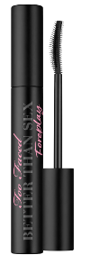
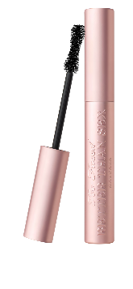
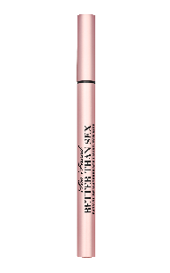




LASH & DASH
Fast, flirty lashes that give you instant drama, perfect for batting & dashing off in style.
CLIENT CONNECTION QUESTION
“Do you want lashes that touch the sky or ones that bring the drama?”
15 MINUTE QUICKIE STEPS
  STEP 1: REMOVE any current mascara from client’s lashes using the below steps.
    Spritz a cotton round with Hangover 3-in-1 Setting Spray until damp.
    Fold cotton round in half & hold under the eye with two fingers in a “V” shape.
    Use Clinique Take The Day Away Makeup Remover on a cotton swab & swipe down on lashes to remove mascara. TIP: wiggle cotton swab into the lashes to get every bit off the lashes.
  STEP 2: MIRROR MOMENT – hand customer a mirror to watch the mascara application.
  STEP 3: PRIME lashes with BETTER THAN SEX FOREPLAY MASCARA PRIMER.
  STEP 4: Using a disposable mascara wand, APPLY mascara choice to one eye with Quickie Move “BOTTOMS FIRST” (bottom lashes first). Use the below application techniques for each formula.
    BETTER THAN SEX MASCARA – BUMP, WIGGLE & TIP
    RIBBON WRAPPED LASH MASCARA – STROKE & TIP
  STEP 5: Time for the second PERFECT PAIRING to complete the lash & dash look! Add customer’s CHOICE OF EYELINER. Smudge or soften using an angled eyeliner brush.
  STEP 6: CLOSE the sale with closing phrases & tips! (Show 3, SELL 2).
Artistry Pro Tip:
Learn as you lash!
Ask client to hold mirror in lap, mirror facing up.
Eyes down, chin up!
Super Coverage Superhero
Share & use BORN THIS WAY SUPER COVERAGE under their eyes in their brightening shade to clean up under the eyes and show off their gorgeous lashes.

Slide 2
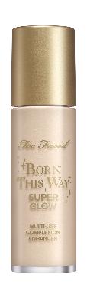
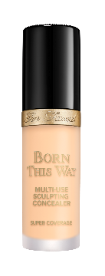
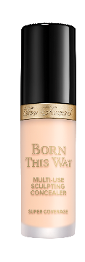
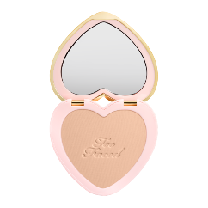
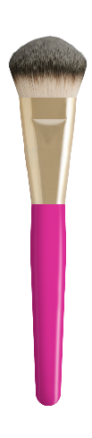
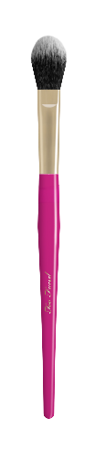
CONCEALER COVER STORY
The perfect concealer hides dark circles, blemishes & unwanted texture while allowing your fresh, flawless face to shine through.
Find your perfect match!
CLIENT CONNECTION QUESTION
“Are we covering up the late-night Netflix binge or just brightening for an instant wake-up call?”
15 MINUTE QUICKIE STEPS
  STEP 1: Always pull TWO SHADES OF CONCEALER: THE POWER COUPLE:
    Corrector Shade: Concealer matches exactly to the foundation for blemishes/redness/pigmentation.
    Brighten Shade: Choose a shade 1-2 shades lighter for under eyes and high points to lift & illuminate.
  STEP 2: BUFF DOWN makeup creases on the customer’s face before the concealer application using a concealer brush.
  STEP 3: MIRROR MOMENT: Hand your customer a makeup mirror to watch the concealer application. Have the customer put their chin up, and eyes up to avoid shadows during the application.
  STEP 4: Using a concealer brush, apply under eyes, on blemishes, or anywhere COVERAGE IS NEEDED.
  STEP 5: BLEND seamlessly with a foundation or concealer brush or TAP into the skin with clean fingers.
  STEP 6: Time for the PERFECT PAIRINGS to complete the coverage! Using a foundation brush, add a touch of BORN THIS WAY SUPER GLOW HIGHLIGHTER for radiance on the cheekbones & highpoints of the customer’s face.
  STEP 7: Using a powder brush, add a touch of BORN THIS WAY SOFT BLUR POWDER to set by tapping in the powder. We don’t bake; WE BLUR.
  STEP 8: CLOSE the sale with closing phrases & tips! (Show 3, SELL 2).
Artistry Pro Tip:
Daniel’s Better Than Sleep Eye Lift:
This is how you wake and fake: Dot Born Thus Way Super Coverage in the inner corner of the eye to cancel shadows.
Dot at the outer corner and then sweep upward toward the temple.
Tap, never rub to melt product into the skin.

