Slide 1
x SEPHORA

Slide 2

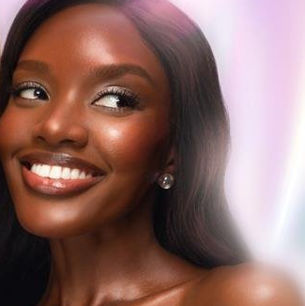
What’s your glow-to look?
SOFT & SWEET GLOW
You love an effortless, subtle glow with a whisper of radiance, totally dreamy.
SUN-KISSED GLOW GETTER
You’re the definition of golden hour. You like a fresh, healthy, lit from within glow.
MAIN CHARACTER GLOW
You don’t walk into a room; you enter the scene. Your glow is bold, fearless & contagious.

Slide 3
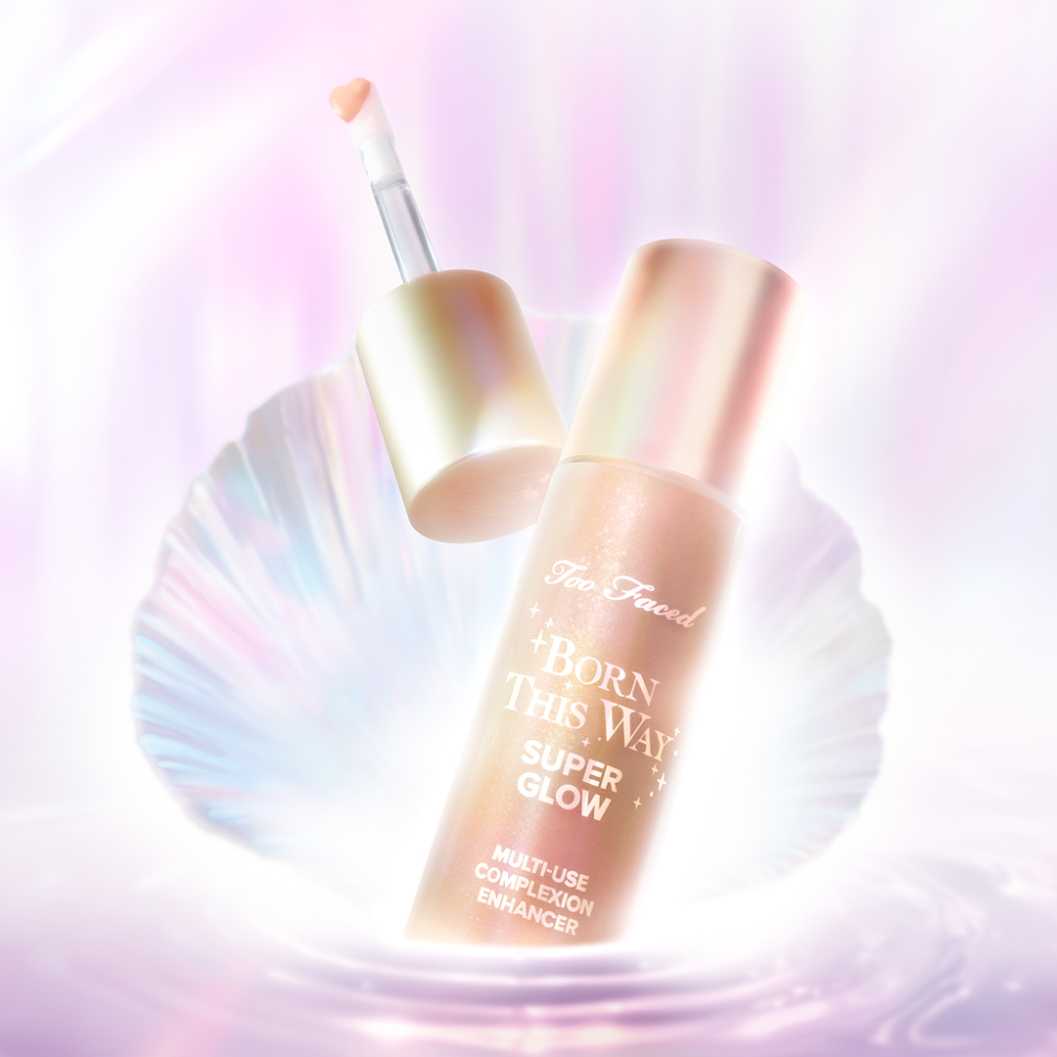



BORN THIS WAY SUPER GLOW
Multi-Use Highlighting Skin Enhancer
Formulated with 80% Skincaring Ingredients for a Hydrated, Luminous Complexion
  Multi-Use Formula Can Be Used on Face & Body to achieve all your skin glowing goals
  Wear Alone or With Makeup
  Smooths & Illuminates Skin’s Appearance
  Formulated With a Complex of 12 Emollients + Hyaluronic Acid
  Hydrating Formula hydrates like skincare
  Always radiant, Never greasy
  Pearlescent & Luminous, never Metallic or Glittery

Slide 4
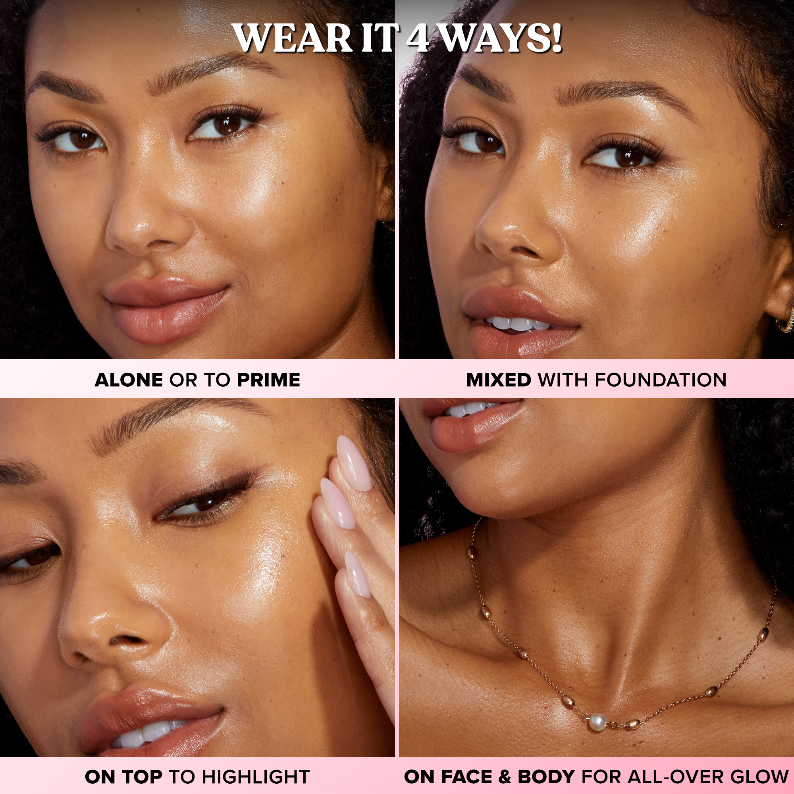
WEAR IT FOUR WAYS!
1. TO PRIME
Apply all over before using Born This Way Foundation for a subtle, lit from within glow.
TIP: For a natural, soft glow apply directly from the wand and blend using fingertips. For a more highlighted and glazed look, stipple with a dense brush.
2. MIXED WITH FOUNDATION
Before you apply, customize your radiance by mixing it with your Born This Way Foundation shade on the back of your hand for a pearl-like finish.
3. ON TOP OF FOUNDATION
After applying your Born This Way Foundation, tap & softly blend along the tops of the cheekbones, down the nose, above the cupid’s bow, etc. for a beaming luminous look.
4. ON FACE & BODY
For an all-over glow, use alone on face, décolleté, or shoulders and anywhere else you want that all-over-glazed glow.

Slide 5
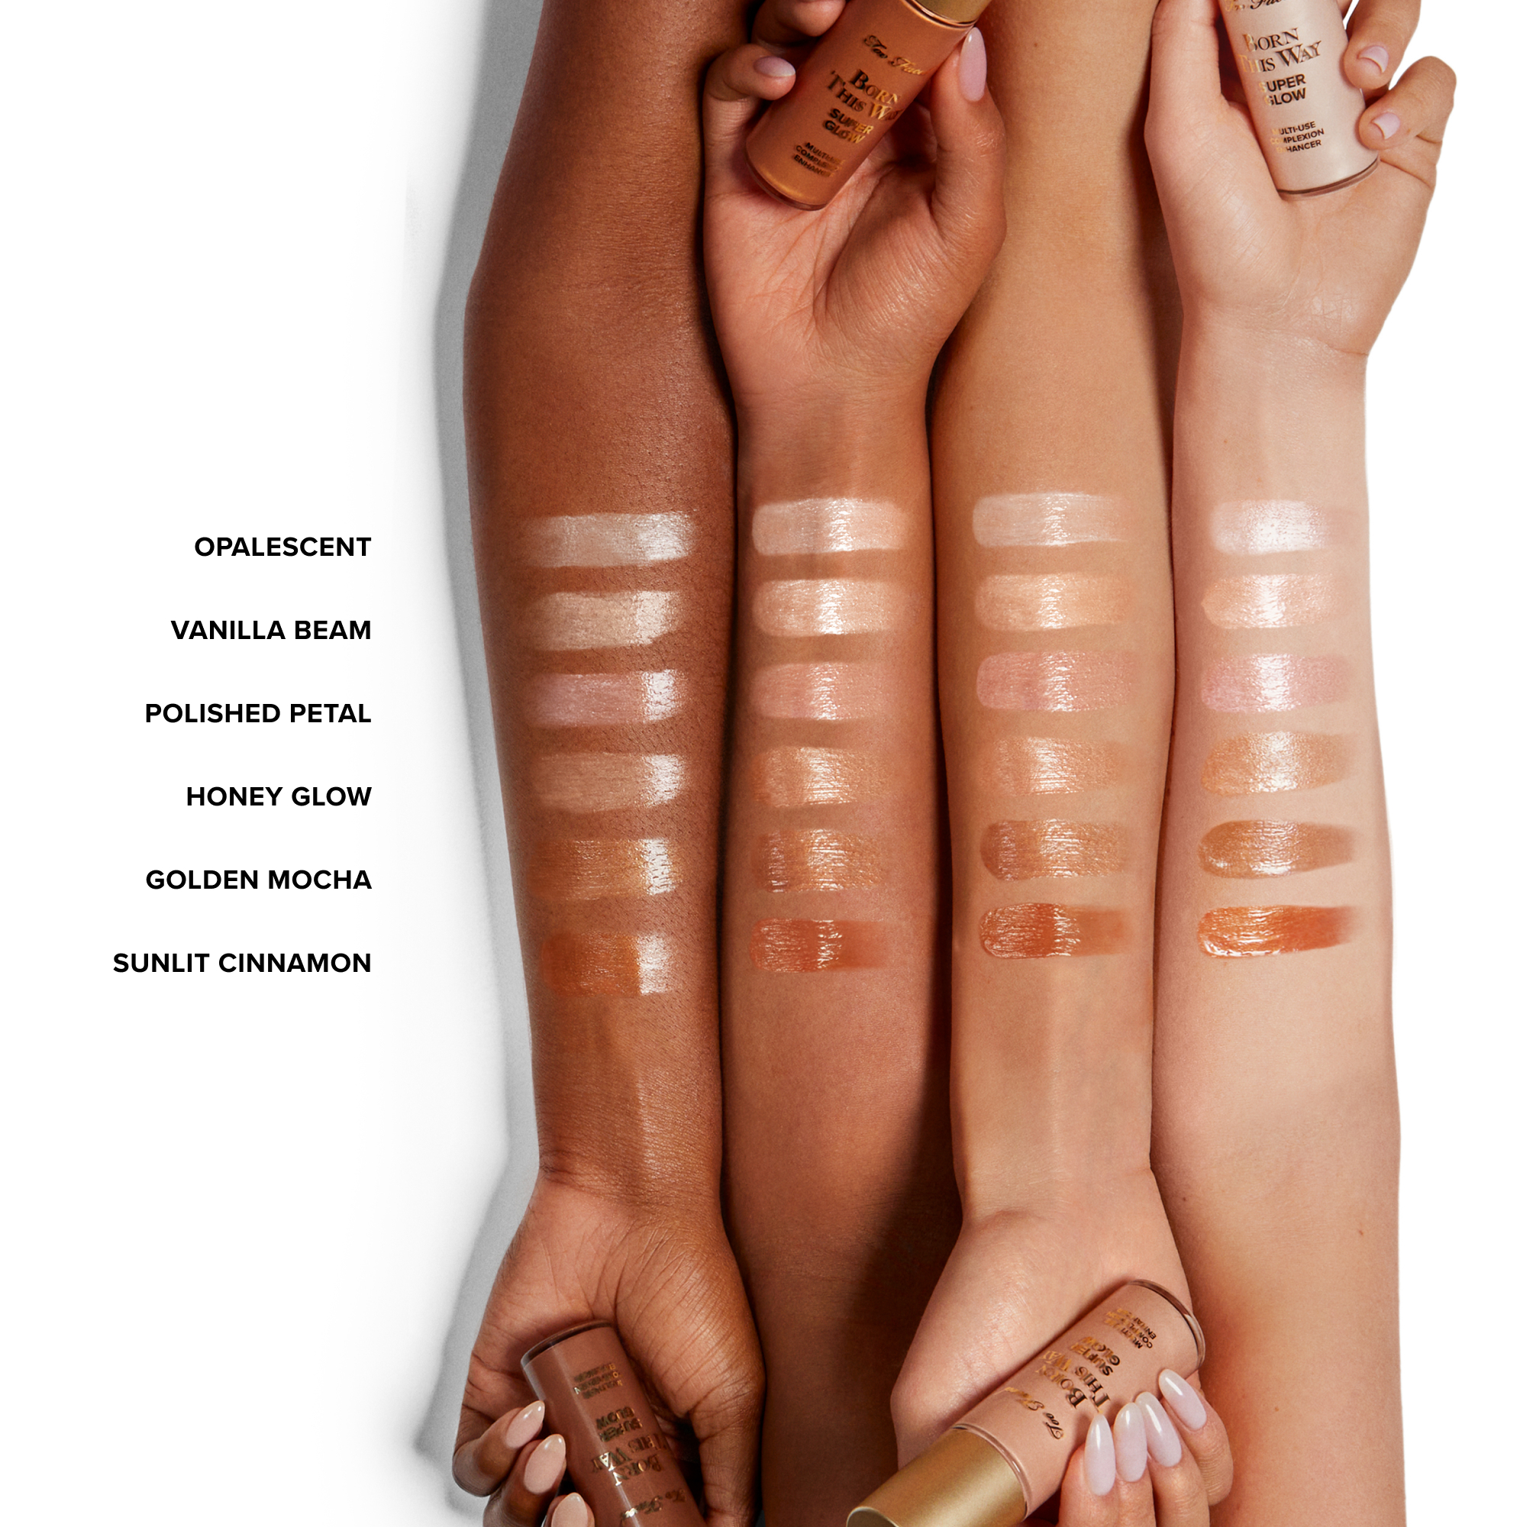
SHADE ASSORTMENT
POINTS OF DIFFERENCE
  80% skincaring ingredients for a hydrated, luminous complexion.
  Not oily or greasy.
  Pearlescent & luminous, never metallic or glittery.
  Smooths & illuminates without drying, settling into lines, or emphasizing texture.
  Anyone can you use any shade.

Slide 6
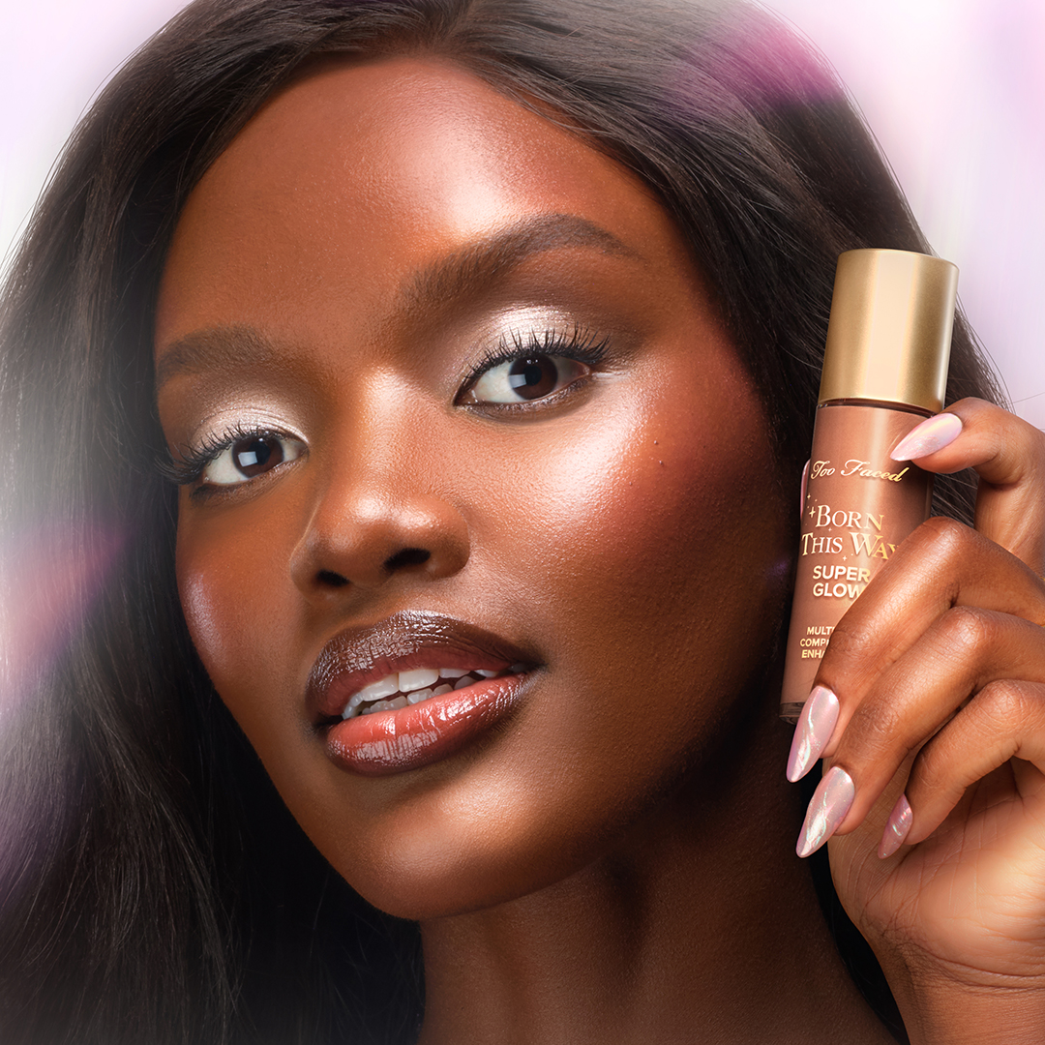
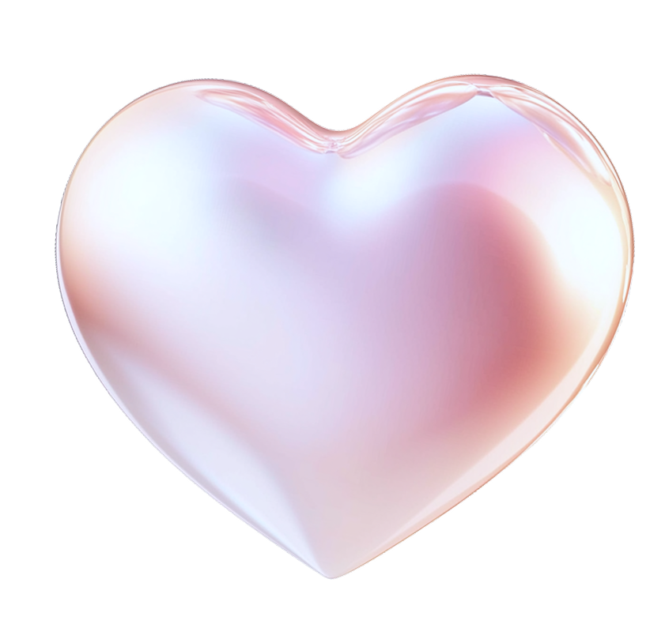
Let’s Introduce it to your clients!
  Looking for a multitasking glow that cares for your skin? Superglow is packed with 80% skincare ingredients, I’d love to apply some on the back of your hand so you can experience the immediate hydration and radiance.
  Want the glow without the glitter? This formula gives a pearlescent, luminous finish. It’s never metallic or sparkly. Let me show you the 4 ways you can wear it!
TF BFFs
Born This Way Foundation
Born This Way
Super Coverage

Slide 7
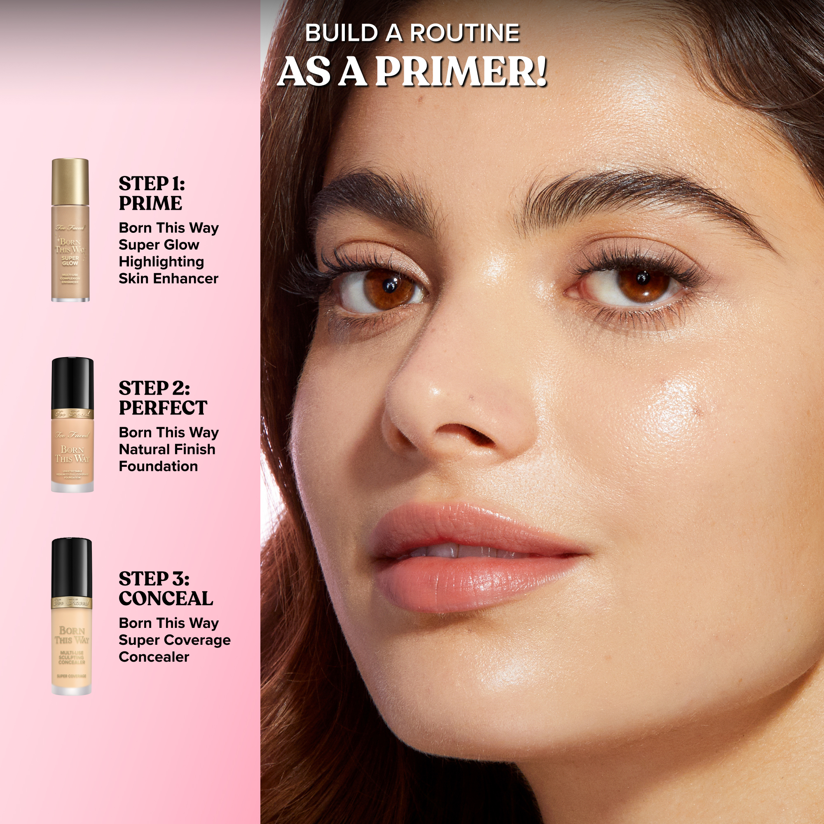
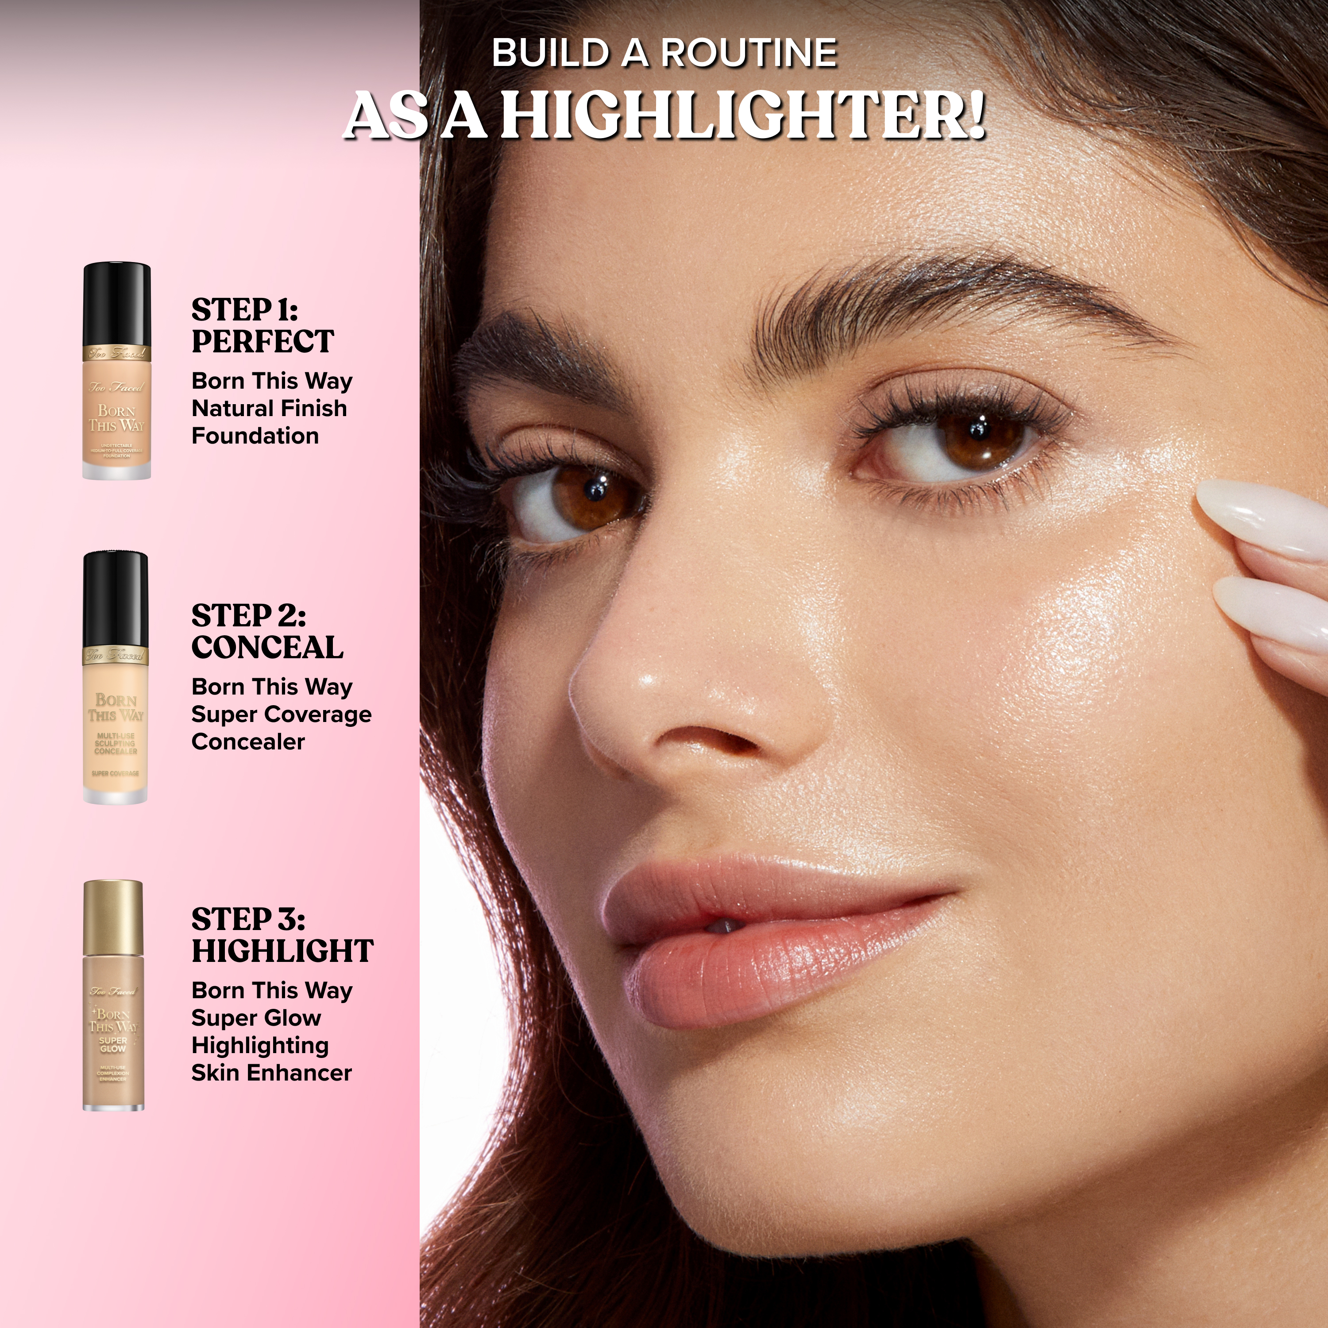
BORN THIS WAY SUPER GLOW
Multi-Use Highlighting Skin Enhancer
PRIMER
HIGHLIGHTER

Slide 8
LIP INJECTION
LIP GLOSS

Slide 9
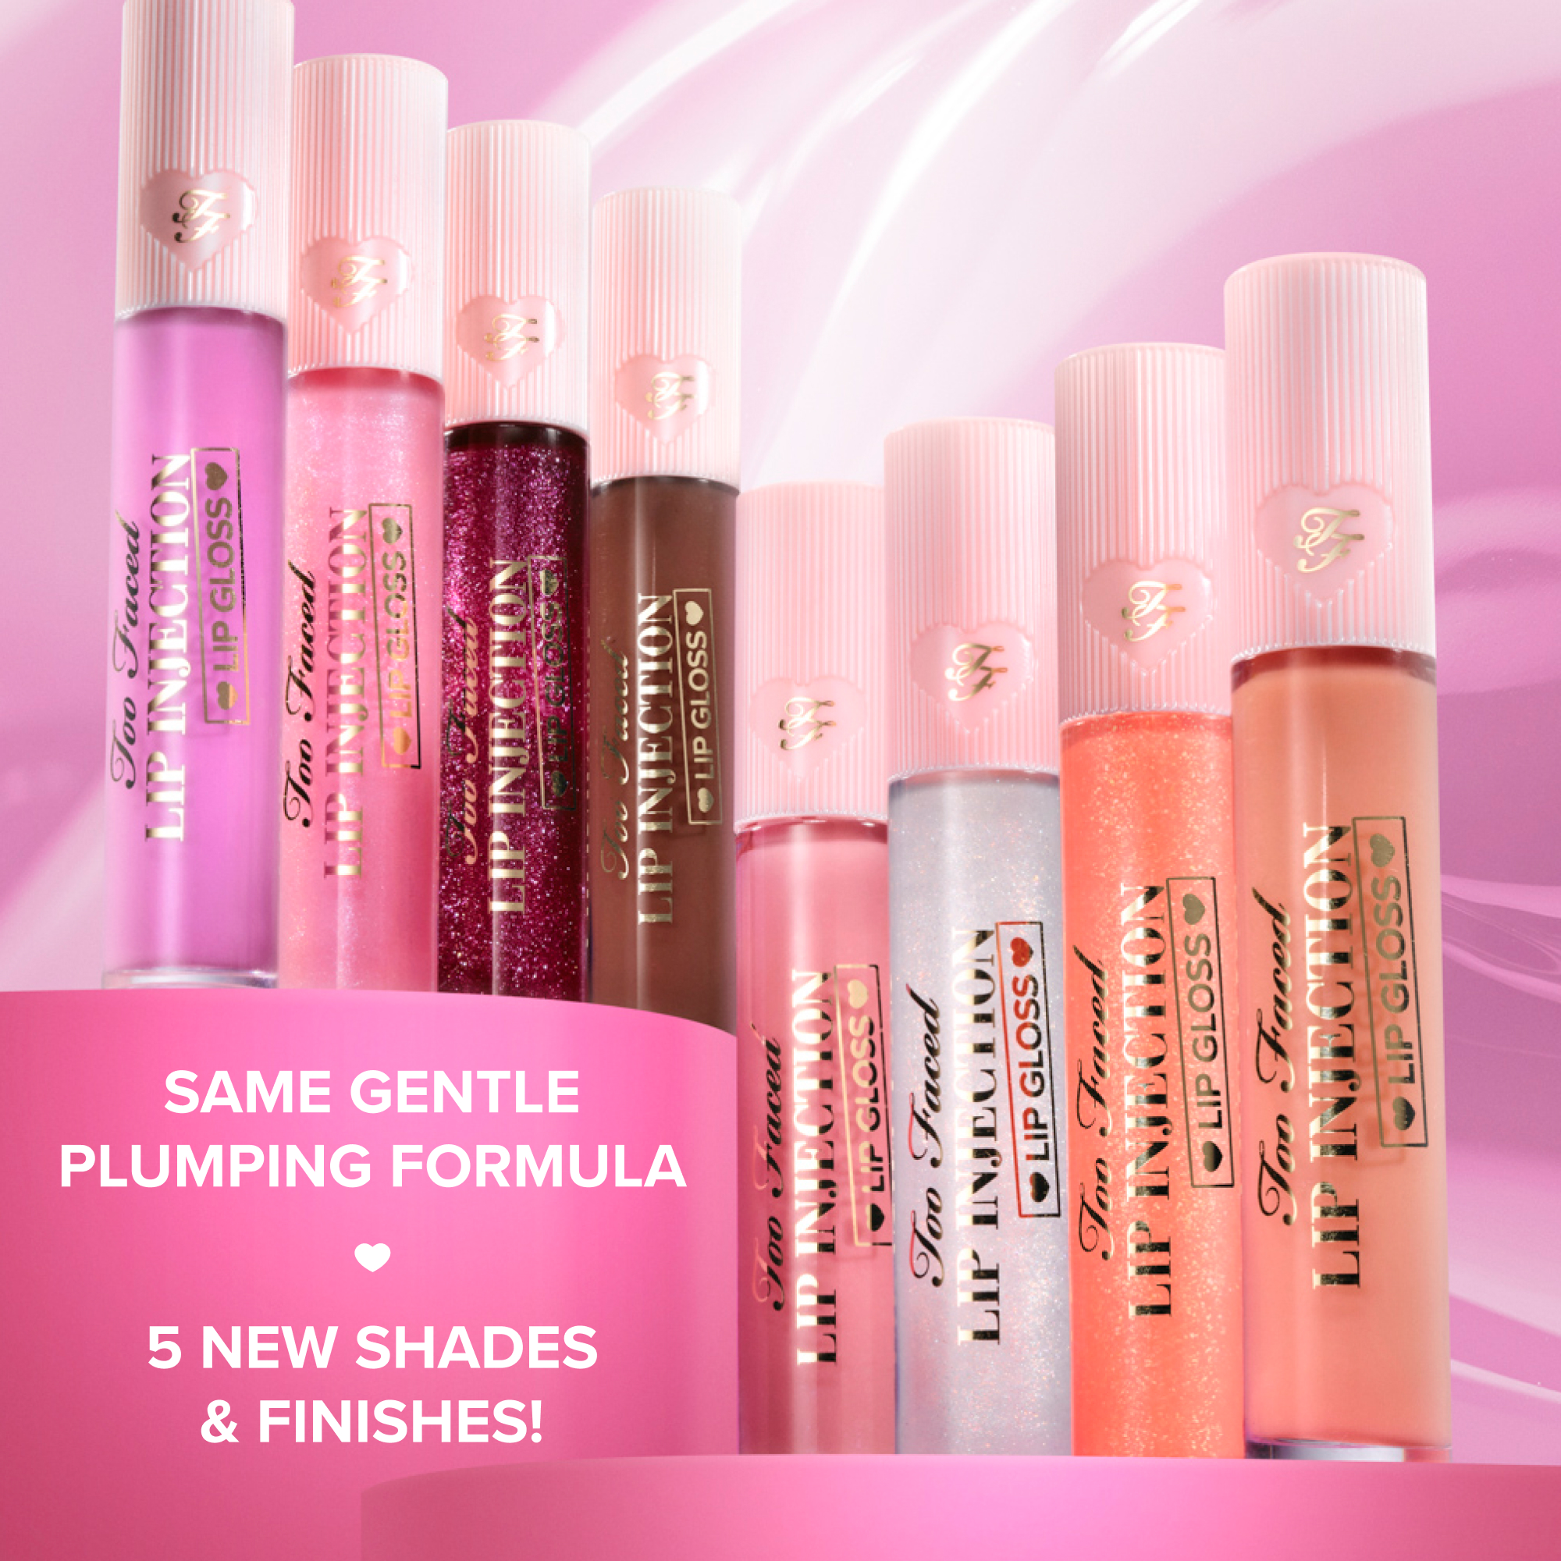

LIP INJECTION LIP GLOSS
Cooling Instant Lip Plumper
Gentle Cooling, Smoother Lips & A Pretty Plump
  Instant Lip Plump with a Cooling Sensation
  No Burning Sensation Plumping Power
  Hydrating Formula
  Lips Appear Instantly Smoother
  High-Shine Glosses & Shimmers
  Available in 8 Shades, Including 5 New Ones!
TF BFFs
Pillow Balm
Lip Shaper
Born This Way
Super Coverage

Slide 10
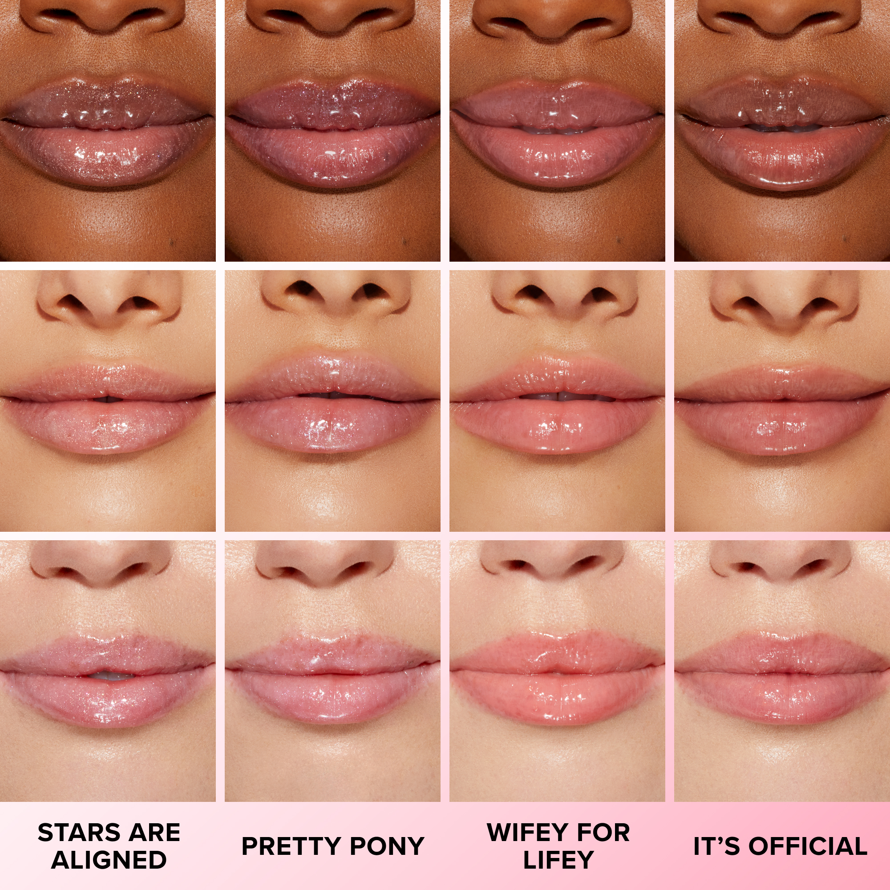
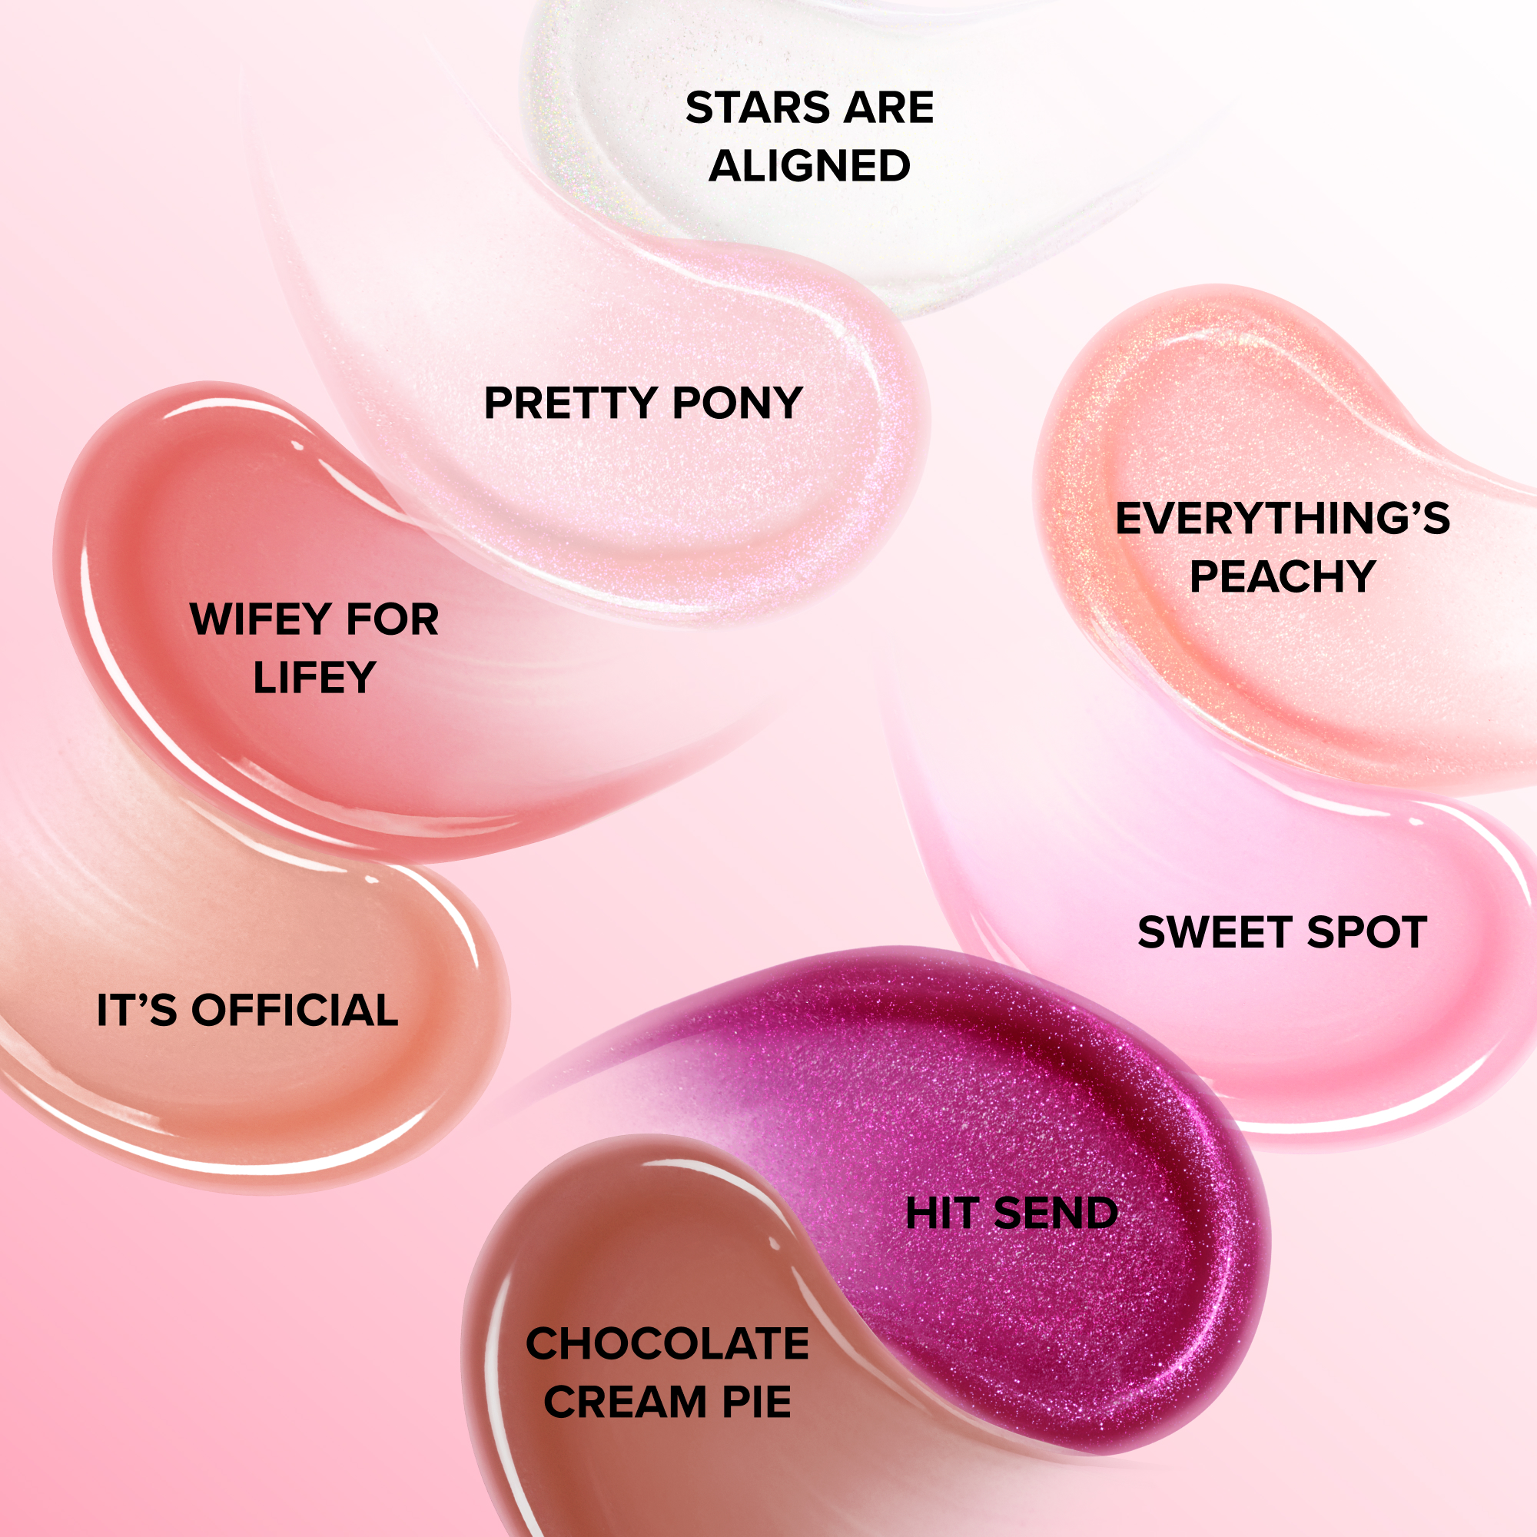
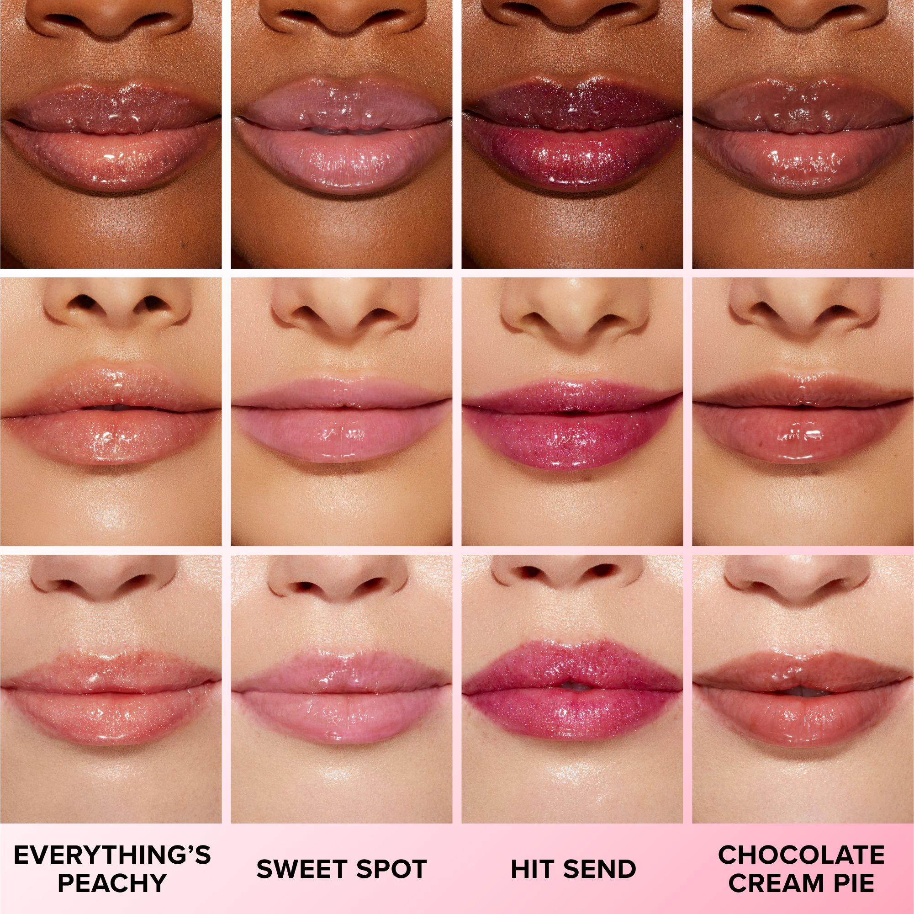
LIP INJECTION LIP GLOSS
Cooling Instant Lip Plumper
Shade Swatches

Slide 11
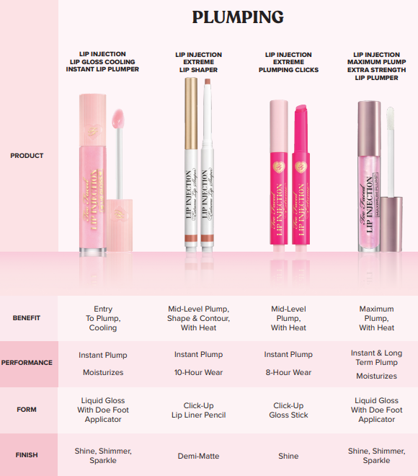
Lip Plumping Comparison Chart

Slide 12

PINK
1. What client will fall in love with Born This Way Super Glow?
2. How could you introduce Super Glow to your client shopping their favorite moisturizer?
3. How is Lip Injection Lip Gloss different from Lip Injection Maximum Plump?

